Slide 1
The Life & Reign of King Asa How Is Your Trajectory for the Lord?
I will ask some questions about your children shortly.
We will pray for the Lord to apprehend all our children.
But what about you parents? Who is pointed to heaven?
Is your trajectory the steepest upward ever, or declining?
Your religion is a sham if content with children or yourself.

Slide 2
The Life & Reign of King Asa How Is Your Trajectory for the Lord?
I will ask some questions about your children shortly.
We will pray for the Lord to apprehend all our children.
But what about you parents? Who is pointed to heaven?
Is your trajectory the steepest upward ever, or declining?
Your religion is a sham if content with children or yourself.

Slide 3
The Life & Reign of King Asa How Is Your Trajectory for the Lord?
King Asa ... 4th from David ... son was Jehoshaphat.
He began with revival and success but finished poorly.
He reigned 41 years, dying with honor but not with God.
Four chapters record him, but he missed a great promise.
Let us not relax our trajectory but change from glory to glory!

Slide 4
The Life & Reign of King Asa How Is Your Trajectory for the Lord?
I will ask some questions about your children shortly.
We have prayed for God to apprehend all our children.
But what about you parents? Who is pointed to heaven?
Is your trajectory the steepest upward ever, or flattened?
Do not comfort yourself about children unless exceptional.

Slide 5
And Asa did that which was right in the eyes of the LORD,
as did David his father.
I Kings 15:11

Slide 6
And Asa did that which was good and right
in the eyes of the LORD his God:
II Chronicles 14:2

Slide 7
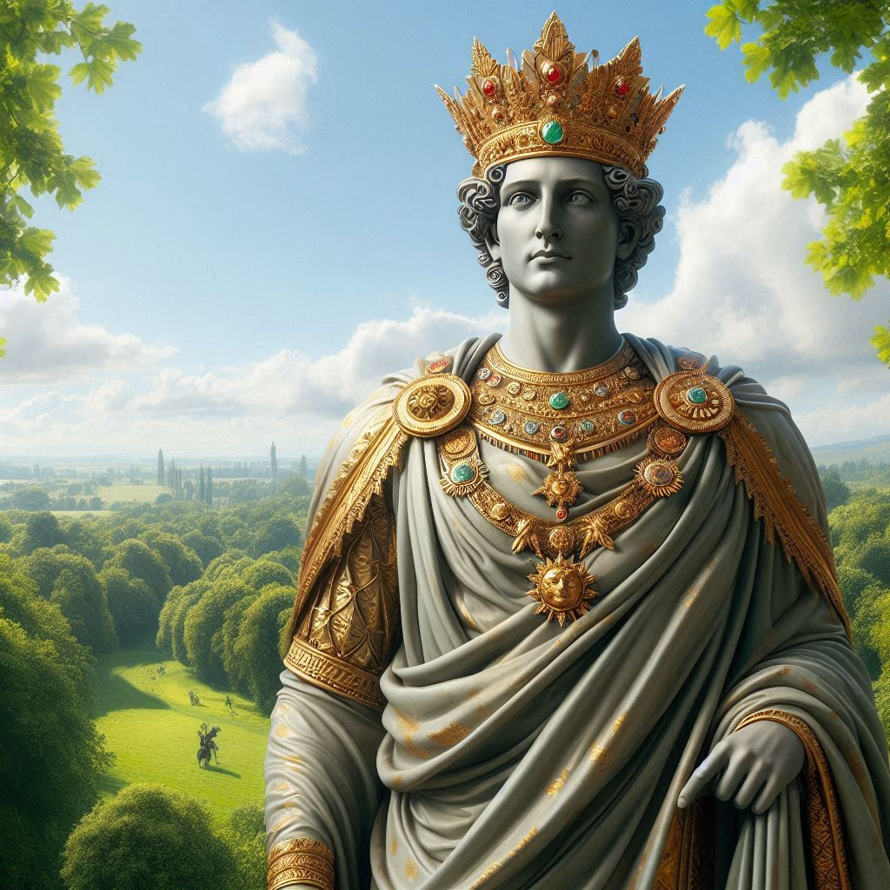

Slide 8
For he took away the altars of the strange gods,
and the high places, and brake down the images,
and cut down the groves:
II Chronicles 14:3

Slide 9
Also he took away out of all the cities of Judah
the high places and the images: and the
kingdom was quiet before him.
II Chronicles 14:5

Slide 10
God may arrange circumstances for you to stand and choose Him against parents.
Asa obeyed the LORD against both.

Slide 11
And he took away the sodomites out of the land,
and removed all the idols that his fathers had made.
I Kings 15:12

Slide 12
And also concerning Maachah the mother of Asa the king,
he removed her from being queen, because she had made an idol in a grove: and Asa cut down her idol, and stamped it,
and burnt it at the brook Kidron.
II Chronicles 15:16

Slide 13
But the high places were not removed:
nevertheless Asa’s heart was perfect with the LORD all his days.
I Kings 15:14

Slide 14
But the high places were not taken away out of Israel: nevertheless the heart of Asa was perfect all his days.
II Chronicles 15:17

Slide 15
We will learn that Asa’s heart was not perfect all his days. We reconcile by seeing Asa was strong against idolatry all his days.

Slide 16
We must not comfort ourselves that we are faithful in one part of our lives but compromise or are faulty in other parts.

Slide 17
And there came out against them Zerah the Ethiopian
with an host of a thousand thousand,
and three hundred chariots;
and came unto Mareshah.
II Chronicles 14:9

Slide 18
Though at this time, Asa’s 15th year, he had sought the Lord, God sent him a large trial.

Slide 19
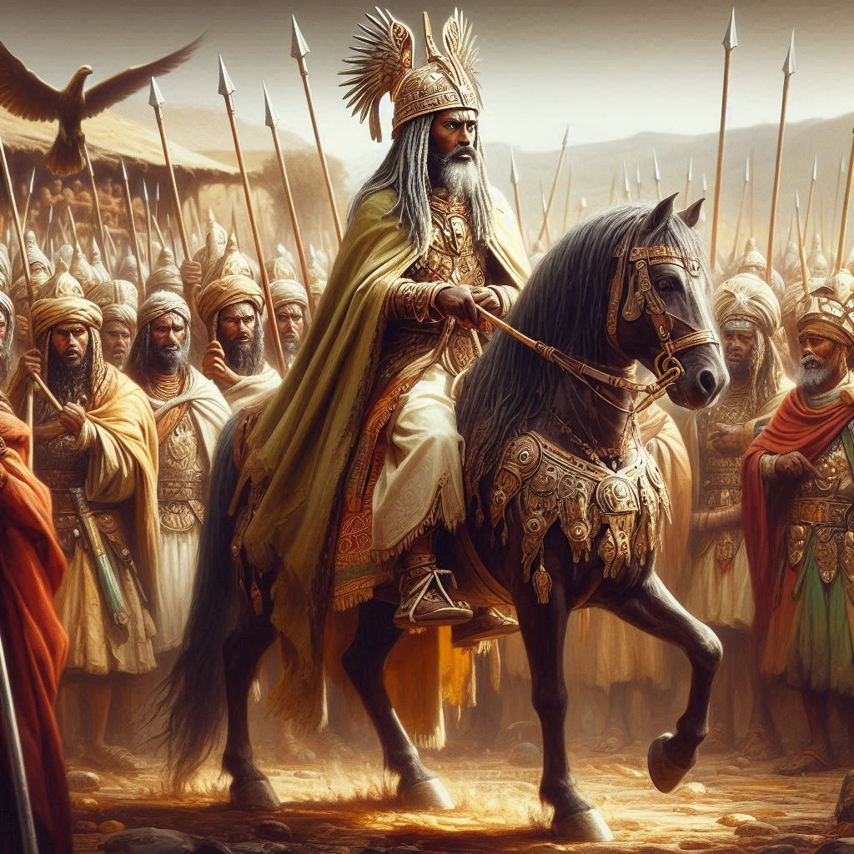

Slide 20
And Asa cried unto the LORD his God, and said,
LORD, it is nothing with thee to help, whether
with many, or with them that have no power:
help us, O LORD our God; for we rest on thee,
and in thy name we go against this multitude.
O LORD, thou art our God; let not man prevail against thee.
II Chronicles 14:11

Slide 21
His prayer is one of the best short prayers in the Bible appealing to God’s glory over man and declaring his full confidence.

Slide 22
So the LORD smote the Ethiopians
before Asa, and before Judah;
and the Ethiopians fled.
II Chronicles 14:12

Slide 23
And the Spirit of God came upon Azariah the son of Oded:
And he went out to meet Asa, and said unto him,
Hear ye me, Asa, and all Judah and Benjamin;
The LORD is with you, while ye be with him;
and if ye seek him, he will be found of you;
but if ye forsake him, he will forsake you.
II Chronicles 15:1-2

Slide 24
Be ye strong therefore,
and let not your hands be weak:
for your work shall be rewarded.
II Chronicles 15:7

Slide 25
And he gathered all Judah and Benjamin, and the strangers
with them out of Ephraim and Manasseh, and out of Simeon:
for they fell to him out of Israel in abundance, when
they saw that the LORD his God was with him.
II Chronicles 15:9

Slide 26
Revival of greater fear and joy of the LORD is the best means of evangelism, even
with former proud enemies.

Slide 27
Asa and the people of Judah believed the reward promised by Azariah and entered into a strict covenant to seek the LORD.

Slide 28
And they entered into a covenant to seek the LORD God
of their fathers with all their heart and with all their soul;
That whosoever would not seek the LORD God of Israel
should be put to death, whether small or great,
whether man or woman.
And they sware unto the LORD with a loud voice,
and with shouting, and with trumpets, and with cornets.
And all Judah rejoiced at the oath: for they had sworn with all their heart, and sought him with their whole desire; and he was found of them: and the LORD gave them rest round about.
II Chronicles 15:12-15

Slide 29
Asa’s victory was in his 15th year and then had rest for 20 years before his next test.
Do not let God’s favor cause you to relax personal vigilance to be all you should be.

Slide 30
In the six and thirtieth year of the reign of Asa Baasha king of Israel came up against Judah, and built Ramah, to the intent
that he might let none go out or come in to Asa king of Judah.
Then Asa brought out silver and gold out of the treasures
of the house of the LORD and of the king’s house,
and sent to Benhadad king of Syria,
that dwelt at Damascus, saying,
II Chronicles 16:1-2

Slide 31
The only measure of any action is God’s clear word. Asa’s lack of faith and use of
pagans worked ... but offended God.

Slide 32
And at that time Hanani the seer came to Asa king of Judah,
and said unto him, Because thou hast relied on the king of Syria, and not relied on the LORD thy God, therefore is the host
of the king of Syria escaped out of thine hand.
Were not the Ethiopians and the Lubims a huge host,
with very many chariots and horsemen? yet,
because thou didst rely on the LORD,
he delivered them into thine hand.
II Chronicles 16:7-8

Slide 33
Love God’s great promise that follows, but realize Asa lost it by fear without faith
in his last five years (36th to 41st).

Slide 34
For the eyes of the LORD run to and fro throughout the whole earth, to shew himself strong in the behalf of them
whose heart is perfect toward him.
Herein thou hast done foolishly:
therefore from henceforth thou shalt have wars.
II Chronicles 16:9

Slide 35
For the eyes of the LORD run to and fro throughout the whole earth, to shew himself strong in the behalf of them
whose heart is perfect toward him.
Herein thou hast done foolishly:
therefore from henceforth thou shalt have wars.
II Chronicles 16:9

Slide 36
Then Asa was wroth with the seer, and put him in a prison house; for he was in a rage with him because of this thing. And Asa oppressed some of the people the same time.
II Chronicles 16:10

Slide 37
Never resent the messenger (the preacher) for telling you truth. Humble yourself to beg God for mercy to start over.

Slide 38
And Asa in the thirty and ninth year of his reign was diseased in his feet, until his disease was exceeding great:
yet in his disease he sought not to the LORD,
but to the physicians.
II Chronicles 16:12

Slide 39
Facts and Timeline of Asa’s Life
His grandfather was Rehoboam (Abijah). His son was Jehoshaphat.
He abolished idolatry and commanded Judah to seek and obey God.
He went against father and mother to follow the truth against them.
God gave him peace, which he used to fortify Judah with 580k army.
He destroyed the million man army of Ethiopia and took much spoil.
Other than this war he won decisively, Asa had peace for 35 years.
He further returned Judah to God and gained many out of Israel.
But when Baasha of Israel fought him, he hired the Syrians for help.
With his feet diseased in his last two years, he did not seek God.
He reigned 41 years in Judah, had a great revival, did not finish well.

Slide 40
How Are You Doing, Friends?
It does not matter how you did earlier, as Paul said.
God told many good things about Asa earlier in life.
What matters is how you end. Do not let zeal slide.
God gave you precious souls to be trained for Him.
They are gone before you know. Train them tonight.
Are the eyes of the LORD running on your behalf?
I am in the place of Hanani for you tonight.
What will you do?
Fight on!

Slide 41
Select Some Favorites
ABOUT GOD/JESUS | TO GOD/JESUS | BOTH DEPENDING ON VERSE
All Hail the Power of Jesus’ Name 1 | Come, Thou Almighty King 2 | O For A Thousand Tongues 5
O How I Love Jesus 10 | Holy, Holy, Holy 6 | O Worship the King 8
I’d Rather Have Jesus 13 | My Jesus, I Love Thee 18 | Hark! Ten Thousand Harps 31
God Moves In A Mysterious Way 14 | Fairest Lord Jesus 20 | In Songs Of Sublime Adoration 32
Praise Him! Praise Him! 37 | Come, Thou Fount 25 | O Sing Of His Mighty Love 46
Joy To The World 110 | Rock of Ages 51 | Hark! The Herald Angels Sing 118
He Loves Me 134 | Jesus! The Very Thought of Thee 162 | There Is A Fountain 124
Christ Arose 142 | Guide Me, O Thou Great Jehovah 79 | Jesus Paid It All 136
A Mighty Fortress 156 | Show Pity, Lord 89 | When I Survey The Wondrous Cross 158
Hark! The Jubilee Is Sounding 165 | Jesus, Lover Of My Soul 114 | Near To The Heart Of God 169

