Slide 1
Character without Christ
Is Dung

Slide 2
Christian without Christ
Is Dung

Slide 3
My job is to prepare you
to meet Jesus Christ.
But I can only teach and warn;
you must listen and change.
I transfer a burden today.

Slide 4
Children will be emphasized for the way they are being trained, but parents are the real object.

Slide 5
How do you measure your life and those of your spouse and children?

Slide 6
Reflect on how you think of your children and how you speak
of them to others.

Slide 7
Does it matter much if they are married or where they are going to school, working, or living?

Slide 8
Recognition of believers in the N.T. is entirely different from all such aspects of mere natural life.

Slide 9
I have taught you how to measure.
https://letgodbetrue.com/sermons/index/year-2005/a-mighty-mans-life/
https://letgodbetrue.com/sermons/index/year-2010/make-your-life-count/
https://letgodbetrue.com/sermons/index/year-2011/managing-your-life/
https://letgodbetrue.com/sermons/index/year-2011/he-is-altogether-lovely/
https://letgodbetrue.com/sermons/index/year-2011/true-worshippers/
https://letgodbetrue.com/sermons/index/year-2019/the-measure-of-a-man/
https://letgodbetrue.com/sermons/index/year-2020/what-drives-sustains-you/

Slide 10
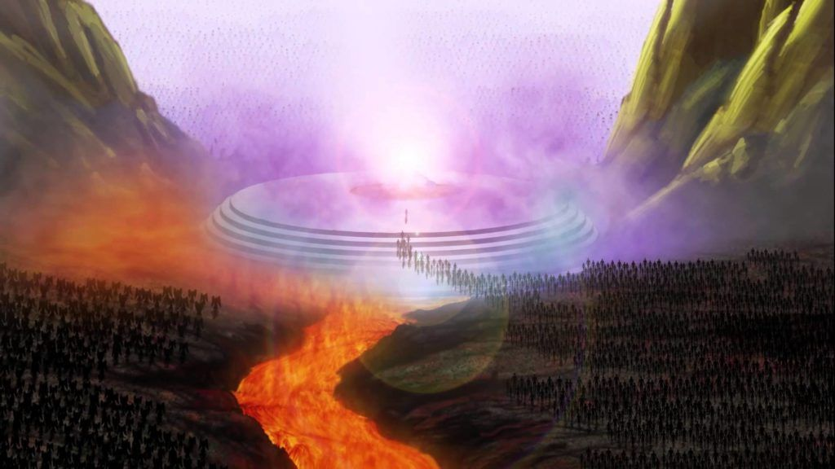

Slide 11
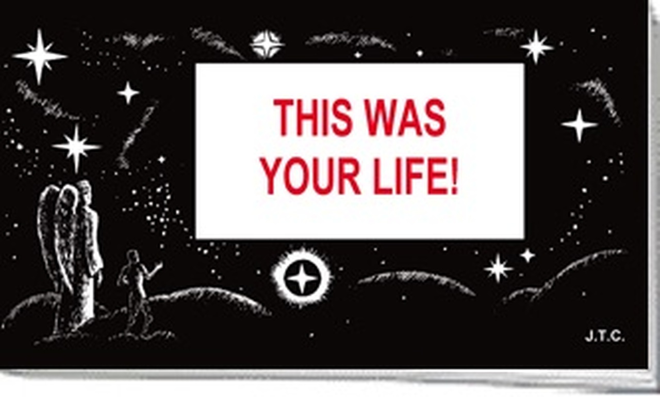

Slide 12
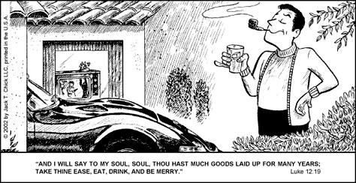

Slide 13
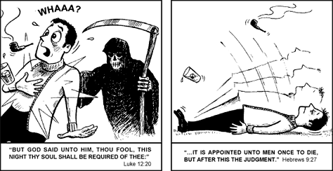

Slide 14
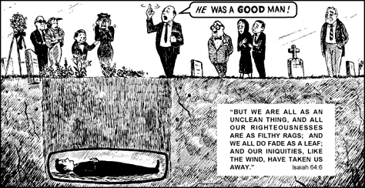

Slide 15
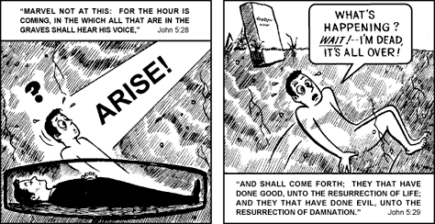

Slide 16
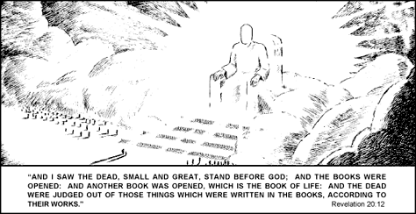

Slide 17


Slide 18
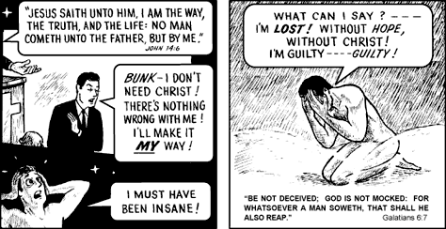

Slide 19
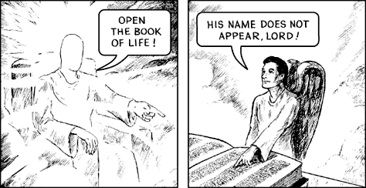

Slide 20
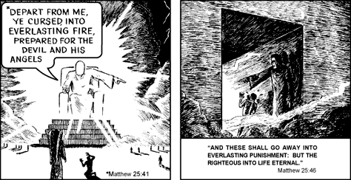

Slide 22
Character without Christ
Is Dung

Slide 23
All the news and noise outside
the Bible and our church is
dangerously worthless.

Slide 24
Who will tell you the truth?

Slide 25
Faithful pastors will tell
you the truth.

Slide 26
But only a few hearers
will appreciate it.

Slide 27
Am I therefore become your enemy,
because I tell you the truth?
Galatians 4:16

Slide 28
These pastors know they must warn you about the coming
judgment seat of Christ.

Slide 29
The highest degree of love is efforts to prepare you to
meet the Judge of all.

Slide 30
Not every one that saith unto me, Lord, Lord,
shall enter into the kingdom of heaven;
but he that doeth the will of my Father
which is in heaven....
And then will I profess unto them,
I never knew you....
Matthew 7:21-23

Slide 31
Knowing therefore
the terror of the Lord,
we persuade men;
but we are made manifest unto God;
and I trust also are made manifest
in your consciences.
II Corinthians 5:10-11

Slide 32
Pastors know most will ignore or reject their words, but they can deliver their own souls.

Slide 33
Yet if thou warn the wicked,
and he turn not from his wickedness,
nor from his wicked way,
he shall die in his iniquity;
but thou hast delivered thy soul.
Ezekiel 3:19

Slide 34
And they, whether they will hear,
or whether they will forbear,
(for they are a rebellious house,)
yet shall know that there hath been
a prophet among them.
Ezekiel 2:5

Slide 35
A faithful pastor knows his job is not to make you feel good
but to do good.

Slide 36
Character without Christ
Is Dung

Slide 37
Character without Christ
Is Dung

Slide 38
Character without Christ
Is Dung and Loss

Slide 39
If you do not get this warning and change for yourself and your family, you lose.

Slide 40


Slide 41
This is the perfect selfie!
I’ll post it on Facebook!

Slide 42
What a wonderful family!
I am fulfilled and happy!

Slide 43
Others can only envy us!
We have the best family!

Slide 44
We were great parents!
All our kids work hard!

Slide 45
We taught them well!
They own their homes!

Slide 46
Our family is the best!
All the kids are happy!

Slide 47
The kids are so happy!
I got them the best toys!

Slide 48
This is the best picture!
My sons got two babes!

Slide 49
What a blessing of God!
All our kids got degrees!

Slide 50
We were the best parents!
Our kids want to visit us!

Slide 51
We were great parents!
Our kids all go to church!

Slide 52
Our kids are loved and respected around town!

Slide 53
God must be pleased with our blessed family!

Slide 54
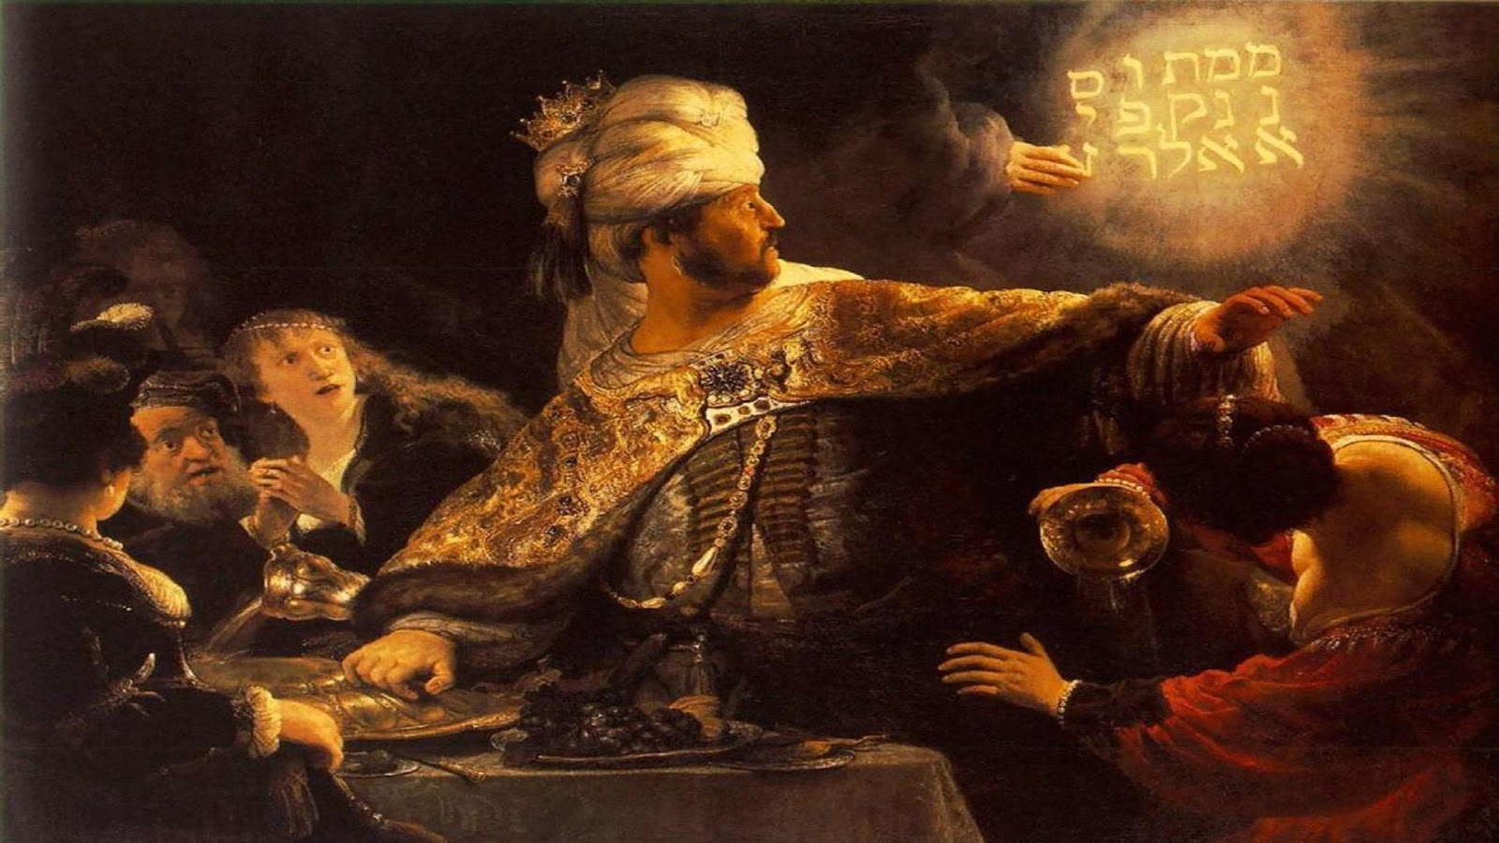
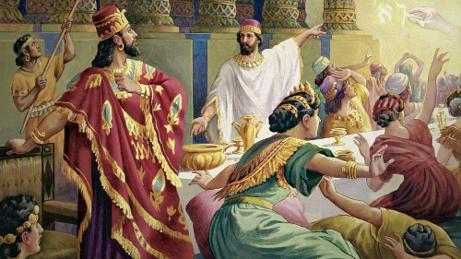

Slide 55
And this is the writing that was written,
MENE, MENE, TEKEL, UPHARSIN.
This is the interpretation of the thing:
MENE; God hath numbered thy kingdom,
and finished it.
TEKEL; Thou art weighed in the balances,
and art found wanting.
Daniel 5:25-27

Slide 56
Having a great family ... in your eyes ... by worldly measures
... is worse than worthless.
Mormons have better families!

Slide 57
Do they love and live for Jesus Christ?

Slide 58
A great family is one dedicated to Jesus Christ, not to school, house, family, job, happiness, fun, etc.

Slide 59
He that findeth his life
shall lose it:
and he that loseth his life
for my sake
shall find it.
Matthew 10:39

Slide 60
For whosoever will save his life
shall lose it:
and whosoever will lose his life
for my sake
shall find it.
Matthew 16:25

Slide 61
Great families would rather have affliction with Christ than
pleasure and riches.

Slide 62
By faith Moses, when he was come to years,
refused to be called the son of Pharaoh’s daughter;
Choosing rather to suffer affliction
with the people of God,
than to enjoy the pleasures of sin for a season;
Esteeming the reproach of Christ
greater riches than the treasures in Egypt:
for he had respect unto the
recompence of the reward.
Hebrews 11:24-26

Slide 63
Character without Christ
Is Dung

Slide 64
Character without Christ
Is Dung

Slide 65
Character without Christ
Is Dung and Loss

Slide 66
Yea doubtless,
and I count all things but loss
for the excellency of the knowledge
of Christ Jesus my Lord:
for whom I have suffered
the loss of all things,
and do count them but dung,
that I may win Christ,
Philippians 3:8

Slide 67
Yea doubtless,
and I count all things but loss
for the excellency of the knowledge
of Christ Jesus my Lord:
for whom I have suffered
the loss of all things,
and do count them but dung,
that I may win Christ,
Philippians 3:8

Slide 68
The Best
Circumcised
Stock of Israel
Tribe of Benjamin
Hebrew of Hebrews
A Strict Pharisee
Much Zeal
Blameless
Much Gain

Slide 69
Brethren, I count not myself
to have apprehended:
but this one thing I do,
forgetting those things
which are behind,
and reaching forth unto those things
which are before,
I press toward the mark
for the prize of the high calling
of God in Christ Jesus.
Philippians 3:13-14

Slide 70
Brethren, I count not myself
to have apprehended:
but this one thing I do,
forgetting those things
which are behind,
and reaching forth unto those things
which are before,
I press toward the mark
for the prize of the high calling
of God in Christ Jesus.
Philippians 3:13-14

Slide 71
An Apostle
The Greatest
To the Gentiles
Wrote Epistles
Endured Trouble
All Spirit Gifts
Many Conversions
Chose Pastors
A Martyr

Slide 72
This pursuit of the apostle Paul should be the most crucial
goal for your family.

Slide 73
The law and the prophets were until John:
since that time the kingdom of God is preached,
and every man presseth into it.
Luke 16:16

Slide 74
And from the days of John the Baptist until now
the kingdom of heaven suffereth violence,
and the violent take it by force.
Matthew 11:12

Slide 75
You cannot serve two masters, though your flesh, the world,
and Satan say you can.

Slide 76
No man can serve two masters:
for either he will hate the one,
and love the other;
or else he will hold to the one,
and despise the other.
Ye cannot serve God and mammon.
Matthew 6:24

Slide 77
Ye adulterers and adulteresses,
know ye not that the friendship
of the world is enmity with God?
whosoever therefore will be a friend
of the world is the enemy of God.
James 4:4

Slide 78
Love not the world,
neither the things that are in the world.
If any man love the world,
the love of the Father is not in him.
I John 2:15

Slide 79
Character without Christ
Is Dung and Loss

Slide 80
You should not have had children if you have not made Christ the most crucial part of their lives.

Slide 81


Slide 82
You should not have had children if you have not made Christ the most crucial part of their lives.

Slide 83
Hard Worker
College Degree
Physically Fit
Baptized at 18
Savings Account
No Public Sins
Good Grades
Attends Church
Respectful

Slide 84
Eagle Scout
Makes Bed
Bible Quizzer
No Tickets
Church Friends
Helps Elderly
Youth Group
Reads Bible
Loves Kids

Slide 85
These measures of “success” are nothing and exist in millions
of reprobates worldwide.

Slide 86
Any other measure you think good is no better than those
in this list, if short of CHRIST.

Slide 87
Hard Worker
College Degree
Physically Fit
Baptized at 18
Savings Account
No Public Sins
Good Grades
Attends Church
Respectful

Slide 88
Eagle Scout
Makes Bed
Bible Quizzer
No Tickets
Church Friends
Helps Elderly
Youth Group
Reads Bible
Loves Kids

Slide 89
We will praise you for doing these things, all the while knowing
they are nothing.

Slide 90
Jesus was about His
Father’s business at 12.
Samuel worshipped God
in Shiloh around 5.

Slide 91
And he said unto them,
How is it that ye sought me?
wist ye not that I must be
about my Father’s business?
Luke 2:49

Slide 92
Therefore also I have lent him to the LORD;
as long as he liveth
he shall be lent to the LORD.
And he worshipped the LORD there.
I Samuel 1:28

Slide 93
I thank the God of glory that my mother sang to me about Jesus Christ before I was born.

Slide 94
She did much more of it and other things pertaining to Christ
after I was born.

Slide 95
What was her favorite verse?
It marks her body at Graceland East.
It is on the front of this pulpit.

Slide 96
For to me to live is Christ,
and to die is gain.
Philippians 1:21

Slide 97
She will have been with Jesus Christ for ten years in
just four days.

Slide 98
When God convicted me about this sermon two weeks ago, my mother had nothing to do with it.

Slide 99
Your credit score important to you?
It is a great measure of character!
What about the one in heaven?

Slide 100
Laying up in store for themselves
a good foundation
against the time to come,
that they may lay hold on eternal life.
I Timothy 6:19

Slide 101
Jesus Christ is the criteria.

Slide 102
Jesus Christ is the measure.

Slide 103
Jesus Christ is the standard.

Slide 104
Jesus Christ is the objective.

Slide 105
First Sermon 7/11/2021
Through slide #105
Second Sermon 7/11/2021
Slides #106 - #203

Slide 106
Without faith and love of Jesus Christ, all character and conduct are worthless before a holy God.

Slide 107
An high look,
and a proud heart,
and the plowing
of the wicked,
is sin.
Proverbs 21:4

Slide 108
The thought of foolishness is sin:
and the scorner is an abomination to men.
Proverbs 24:9

Slide 109
And he that doubteth
is damned if he eat,
because he eateth
not of faith:
for whatsoever is not of faith
is sin.
Romans 14:23

Slide 110
Jesus Christ was strict and severe even with His churches by Paul
at Ephesus and Laodicea.

Slide 111
I know thy works,
and thy labour, and thy patience
and how thou canst not bear them which are evil:
and thou hast tried them which say they are apostles,
and are not, and hast found them liars:
And hast borne, and hast patience,
and for my name’s sake hast laboured,
and hast not fainted.
Revelation 2:2-3

Slide 112
Nevertheless I have somewhat against thee,
because thou hast left thy first love.
Remember therefore from whence thou art fallen,
and repent, and do the first works;
or else I will come unto thee quickly,
and will remove thy candlestick out of his place,
except thou repent.
Revelation 2:4-5

Slide 113
I know thy works,
that thou art neither cold nor hot:
I would thou wert cold or hot.
So then because thou art lukewarm,
and neither cold nor hot,
I will spue thee out of my mouth.
Revelation 3:15-16

Slide 114
Because thou sayest,
I am rich, and increased with goods,
and have need of nothing;
and knowest not
that thou art wretched,
and miserable,
and poor,
and blind,
and naked:
Revelation 3:17

Slide 115
Why did you have children and not point them always and
only to Jesus Christ?

Slide 116
Show them life is all about Him!
Only then try to tell them of Him.

Slide 117
What Are Your Pastor’s Favorites?
Favorite Psalm ... _______ ... Why?
Favorite Book ... ________ ... Why?
Favorite Song ... ________ ... Why?
Favorite Sermon ... ______ ... Why?

Slide 118
What Are Your Favorites?
Favorite Psalm ... _______ ... Why?
Favorite Book ... ________ ... Why?
Favorite Song ... ________ ... Why?
Favorite Sermon ... ______ ... Why?

Slide 119
We must do all we can to protect and provoke our children and youth in the right direction.

Slide 120
What is the right direction?
It is not character without Christ.
It is Christ first and then character.

Slide 121
Forget all the fatalistic nonsense of whether they are born again
or not; stress the right goals.

Slide 122
Old folks must examine their lives to see if they had poor priorities.
It is better to end your life like Manasseh than like Solomon.

Slide 123
You think diligence is good?
No pastor has preached it harder.
But it is nothing without Christ.

Slide 124
Many reprobates around
the world and in our city
outwork your children!

Slide 125
She seeketh wool, and flax,
and worketh willingly with her hands.
Proverbs 31:13

Slide 126
She riseth also while it is yet night,
and giveth meat to her household,
and a portion to her maidens.
Proverbs 31:15

Slide 127
She girdeth her loins with strength,
and strengtheneth her arms.
Proverbs 31:17

Slide 128
She looketh well to the ways of her household,
and eateth not the bread of idleness.
Proverbs 31:27

Slide 129
Favour is deceitful, and beauty is vain:
but a woman that feareth the LORD,
she shall be praised.
Proverbs 31:30

Slide 130
Favour is deceitful, and beauty is vain:
but a woman that loveth CHRIST,
she shall be praised.
Proverbs 31:30 (N.T. Version)

Slide 131
Anyone can be diligent.
There are nations known for it.

Slide 132
Anyone can be disciplined.
Paul used reprobates to illustrate it.
Animals are trained past many men.

Slide 133
Only diligence on the job done to Jesus Christ works to please God.

Slide 134
Servants, obey in all things
your masters according to the flesh;
not with eyeservice, as menpleasers;
but in singleness of heart, fearing God:
And whatsoever ye do, do it heartily,
as to the Lord, and not unto men;
Knowing that of the Lord ye shall receive
the reward of the inheritance:
for ye serve the Lord Christ.
Colossians 3:22-24

Slide 135
Servants, be obedient to them
that are your masters according to the flesh,
with fear and trembling,
in singleness of your heart
as unto Christ;
Not with eyeservice, as menpleasers;
but as the servants of Christ,
doing the will of God from the heart;
With good will doing service,
as to the Lord, and not to men:
Ephesians 6:5-7

Slide 136
Pastor, don’t you think you are making too little of good
character in kids?

Slide 137
Reprobates or Losers with Great Character
Esau | Loved his father; worked hard; remarried for them.

Slide 138
Reprobates or Losers with Great Character
Esau | Loved his father; worked hard; remarried for them.
Saul of Kish | Modest and worked hard to find his father’s asses.

Slide 139
Reprobates or Losers with Great Character
Esau | Loved his father; worked hard; remarried for them.
Saul of Kish | Modest and worked hard to find his father’s asses.
Sons of Zeruiah | Ferociously loyal relatives of David with great skills.

Slide 140
Reprobates or Losers with Great Character
Esau | Loved his father; worked hard; remarried for them.
Saul of Kish | Modest and worked hard to find his father’s asses.
Sons of Zeruiah | Fabulously loyal relatives of David with ambition.
Jeroboam of Nebat | Very industrious young man that got Solomon’s eye.

Slide 141
Reprobates or Losers with Great Character
Esau | Loved his father; worked hard; remarried for them.
Saul of Kish | Modest and worked hard to find his father’s asses.
Sons of Zeruiah | Fabulously loyal relatives of David with ambition.
Jeroboam of Nebat | Very industrious young man that got Solomon’s eye.
Judas Iscariot | Not even the other apostles knew he was a devil.

Slide 142
You should not marry unless you and your prospect are
fully Christ’s.

Slide 143
This qualification is not church membership or anything
so pitiful and weak.

Slide 144
This is marrying as high as you can in the Lord as measured by a
very crucial factor.

Slide 145
The chief need for a power
couple is their love and
dedication to Christ.

Slide 147
Pastor, don’t you think you are making this a bigger issue
than it truly is?

Slide 148
David was a man after God’s own heart, but he sinned even
worse than me.

Slide 149
Other than those blips in his life, he loved and lived for God more than you ever imagined doing.

Slide 150
Do your children love Jesus Christ and want to serve Him only
in all things they do?

Slide 151
Three Basic Rules
“Whether therefore ye eat, or drink, or whatsoever ye do, do all to the glory of God. Give none offence, neither to the Jews, nor to the Gentiles, nor to the church of God: Even as I please all men in all things, not seeking mine own profit, but the profit of many, that they may be saved” (I Cor 10:31-33).
#1: Everything you say and do should be to God’s glory.
#2: Everything you say and do should not offend others.
#3: Everything you say and do is to convert sinners.

Slide 152
And whatsoever ye do
in word or deed,
do all in the name
of the Lord Jesus,
giving thanks to God
and the Father
by him.
Colossians 3:17

Slide 153
Are they known for bearing spiritual fruit in service
to Jesus Christ?

Slide 154
Abide in me, and I in you.
As the branch cannot
bear fruit of itself,
except it abide
in the vine;
no more can ye,
except ye abide in me.
John 15:4

Slide 155
Only spiritual fruit counts with God and righteous men, not
jobs, money, fitness, etc.

Slide 156
And this I pray,
that your love may abound
yet more and more
in knowledge and in all judgment;
That ye may approve things that are excellent;
that ye may be sincere and without offence
till the day of Christ;
Being filled with the fruits of righteousness
which are by Jesus Christ,
unto the glory and praise of God.
Philippians 1:9-11

Slide 157
FAITH seeks, not mental assent.
LOVE sacrifices to serve saints.
JOY is in the Lord, not just life.
PATIENCE endures by a hope.
FORGIVENESS copies Jesus.

Slide 158
Compare Character to Christ
Works Hard Prays Hard
Good Grades Good Works
Builds Savings Builds Souls
Cleans Room Cleans Heart
Knows Job Knows Bible

Slide 159
Good Grades or Good Works
Computers Loves Souls
Psychology Joyful in God
Literature Peace in Christ
Finance Devours Bible
Engineering Always Spiritual

Slide 160
Real character ... character that counts ... is to be like Christ.

Slide 161
Real character ... character that counts ... is to live for Christ.

Slide 162
But put ye on the Lord Jesus Christ,
and make not provision for the flesh,
to fulfil the lusts thereof.
Romans 13:14

Slide 163
Ye are our epistle written in our hearts,
known and read of all men:
Forasmuch as ye are manifestly declared
to be the epistle of Christ
ministered by us,
written not with ink,
but with the Spirit of the living God;
not in tables of stone,
but in fleshy tables of the heart.
II Corinthians 3:2-3

Slide 164
Even our love and service
to others must be for
Christ’s sake.

Slide 165
And the King shall answer
and say unto them,
Verily I say unto you,
Inasmuch as ye have done it
unto one of the least
of these my brethren,
ye have done it unto me.
Matthew 25:40

Slide 166
Let all bitterness, and wrath,
and anger, and clamour,
and evil speaking,
be put away from you,
with all malice:
And be ye kind one to another,
tenderhearted, forgiving one another,
even as God for Christ’s sake hath forgiven you.
Ephesians 4:31-32

Slide 167
Competition out of pride is called emulation in the Bible.
It is a sin.

Slide 168
But there is competition that can be godly if done only for
Christ’s glory.

Slide 169
Jesus saith to Simon Peter,
Simon, son of Jonas,
lovest thou me more than these?
He saith unto him, Yea, Lord;
thou knowest that I love thee.
He saith unto him, Feed my lambs.
John 21:15

Slide 170
Bible examples show mercy for faults, weakness, or ignorance
by great love for God (Christ).

Slide 171
David did that which was right
in the eyes of the LORD,
and turned not aside
from any thing that he commanded him
all the days of his life,
save only in the matter of Uriah the Hittite.
I Kings 15:5

Slide 172
But the high places were not removed:
nevertheless Asa’s heart was perfect
with the LORD all his days.
I Kings 15:14

Slide 173
Work is not the measure of a man, but rather what a man does
after he must work.

Slide 174
Work or Works After Work
Takes Overtime All Services
Maxes out 401k Eager for Bible
Gets Promoted Friends of Jesus
Employee of Week Reviews Sermons
Takes Work Home Delights in God

Slide 175
Do they initiate conversation about Jesus Christ?

Slide 176
Do they crave and make time with God and the Bible to meet Jesus?

Slide 177
And thou shalt love
the Lord thy God
with all thy heart,
and with all thy soul,
and with all thy mind,
and with all thy strength:
this is the first commandment.
Mark 12:30

Slide 178
How do you
and your children
show the love?

Slide 179
Church attendance?
Bible Quizzing?
Youth Group?

Slide 180
These are not a personal relationship with Jesus Christ
and a life sold out for Him.

Slide 181
Christ Jesus Himself!
Not Baptism
Not Doctrine
Not Church
Not Family
Not Bible

Slide 182
Christ Jesus Himself!
Not just facts about Jesus Christ!

Slide 183
Do not let the Bible be for a reading chart, for quizzing,
but to meet Jesus Christ.

Slide 184
Search the scriptures;
for in them ye think
ye have eternal life:
and they are they
which testify of me.
John 5:39

Slide 185
The scribes and Pharisees knew the Bible better than any quizzer.
They murdered Jesus Christ!

Slide 186
There is all kinds of knowledge, truth, and wisdom in the Bible.
But it is the revelation of God’s Son that trumps all revelation.

Slide 187
And without controversy
great is the mystery of godliness:
God was manifest in the flesh,
justified in the Spirit,
seen of angels,
preached unto the Gentiles
believed on in the world,
received up into glory.
I Timothy 3:16

Slide 188
In some ways we exalt Proverbs, though reprobates appreciate it.
But it is the revelation of God’s Son that trumps all revelation.

Slide 189
Almighty God the LORD Jehovah along with His Son have special love for some and live with them.

Slide 190
What is the condition for this special relationship that
only a few realize?

Slide 191
He that hath my commandments,
and keepeth them,
he it is that loveth me:
and he that loveth me
shall be loved of my Father,
and I will love him,
and will manifest myself to him.
John 14:21

Slide 192
If a man love me,
he will keep my words:
and my Father will love him,
and we will come unto him,
and make our abode with him.
John 14:23

Slide 193
What Inputs Do They Emphasize?
Reading Anything Reading the Bible
Talk to Boyfriend Praying to God
Time with Pals Time with Saints
Worldly Music Christian Music
Internet/Movies Sermons, Studies

Slide 194
Do they desire above all else to
be in church for every service?

Slide 195
One thing have I desired of the LORD,
that will I seek after;
that I may dwell in the house of the LORD
all the days of my life,
to behold the beauty of the LORD,
and to enquire in his temple.
Psalm 27:4

Slide 196
We have far more of the beauty of the LORD in a N.T. church than David ever had in the O.T.

Slide 197
What are your spouse, children,
and you alive for and die for?

Slide 198
For whether we live,
we live unto the Lord;
and whether we die,
we die unto the Lord:
whether we live therefore,
or die, we are the Lord’s.
For to this end Christ both died,
and rose, and revived,
that he might be Lord
both of the dead and living.
Romans 14:8-9

Slide 199
Do they have favorite verses, songs, sermons, Psalms, and
books of Bible about Jesus?

Slide 200
Is their greater ambition
a truck or a tithe?

Slide 201
What do they love more?
A paycheck or a promise from
their great high Priest?

Slide 202
Only one life twill soon be past;
Only what’s done for Christ will last.

Slide 203
First Sermon 7/11/2021
Through slide #105
Second Sermon 7/11/2021
Slides #107 - #203

Slide 204
Character without Christ
Is Dung

Slide 205
Character without Christ
Is Dung and Loss

Slide 206
Yea doubtless,
and I count all things but loss
for the excellency of the knowledge
of Christ Jesus my Lord:
for whom I have suffered
the loss of all things,
and do count them but dung,
that I may win Christ,
Philippians 3:8

Slide 207
Yea doubtless,
and I count all things but loss
for the excellency of the knowledge
of Christ Jesus my Lord:
for whom I have suffered
the loss of all things,
and do count them but dung,
that I may win Christ,
Philippians 3:8

Slide 208
The Best
Circumcised
Stock of Israel
Tribe of Benjamin
Hebrew of Hebrews
A Strict Pharisee
Much Zeal
Blameless
Much Gain

Slide 209
Gamaliel
Rhetorician
Authority of Elders
School in Jerusalem
Taught Jewish Traditions
Expert in the Law
Persecuted Christians
Roman Citizen
Great Zeal

Slide 210
Brethren, I count not myself
to have apprehended:
but this one thing I do,
forgetting those things
which are behind,
and reaching forth unto those things
which are before,
I press toward the mark
for the prize of the high calling
of God in Christ Jesus.
Philippians 3:13-14

Slide 211
Brethren, I count not myself
to have apprehended:
but this one thing I do,
forgetting those things
which are behind,
and reaching forth unto those things
which are before,
I press toward the mark
for the prize of the high calling
of God in Christ Jesus.
Philippians 3:13-14

Slide 212
An Apostle
The Greatest
To the Gentiles
Wrote Epistles
Endured Trouble
All Spirit Gifts
Many Conversions
Chose Pastors
A Martyr

Slide 213
Character is a very good goal for children, but without Christ
even it is dung and loss.

Slide 214
Which makes measures less than character even worse in value.
Degree
Grades
Fitness
Income
Cleanliness

Slide 215
Without faith and love of Jesus Christ, all character and conduct are worthless before a holy God.

Slide 216
But without faith
it is impossible to please him:
for he that cometh to God
must believe that he is,
and that he is a rewarder
of them that diligently seek him.
Hebrews 11:6

Slide 217
And thou shalt love
the Lord thy God
with all thy heart,
and with all thy soul,
and with all thy mind,
and with all thy strength:
this is the first commandment.
Mark 12:30

Slide 218
He that loveth father or mother
more than me
is not worthy of me:
and he that loveth son or daughter
more than me
is not worthy of me.
Matthew 10:37

Slide 219
If any man
love not
the Lord Jesus Christ,
let him be
Anathema
Maranatha.
I Corinthians 16:22

Slide 220
Grace be with all them
that love our Lord Jesus Christ
in sincerity. Amen.
Ephesians 6:24

Slide 221
Whom having not seen, ye love;
in whom, though now ye see him not,
yet believing, ye rejoice
with joy unspeakable and full of glory:
I Peter 1:8

Slide 222
We love him,
because he first loved us.
I John 4:19

Slide 223
Nevertheless
I have somewhat against thee,
because thou hast left thy first love.
Revelation 2:4

Slide 224
Without faith and love of Jesus Christ, all character and conduct are worthless before a holy God.

Slide 225
We must do all we can to protect and provoke our children and youth in the right direction.

Slide 226
What is the right direction?
It is not character without Christ.
It is Christ first and then character.

Slide 227
Reprobates or Losers with Great Character
Esau | Loved his father; worked hard; remarried for them.
Saul of Kish | Modest and worked hard to find his father’s asses.
Sons of Zeruiah | Fabulously loyal relatives of David with ambition.
Jeroboam of Nebat | Very industrious young man that got Solomon’s eye.
Judas Iscariot | Not even the other apostles knew he was a devil.

Slide 228
You should not marry unless you and your prospect are
fully Christ’s.

Slide 229
This qualification is not church membership or anything
so pitiful and weak.

Slide 230
This is marrying as high as you can in the Lord as measured by a
very crucial factor.

Slide 231
The chief need for a power
couple is their love and
dedication to Christ.

Slide 232
Character without Christ
Is Dung

Slide 233
Character without Christ
Is Dung and Loss

Slide 234
You do not want to meet Jesus the Lord of glory with “character” but without personal love and service.

Slide 236
This coming event is more certain than anything in your life
including death.

Slide 237
And as it is appointed
unto men once to die,
but after this the judgment:
Hebrews 9:27

Slide 238
This most important event is ignored by pagans and
most Christians.

Slide 239
If we will be faithful to the Bible, then we must bring it up in
all its terrifying glory.

Slide 241
It is revealed as a basic fact from the first generations on earth
to the last book of the Bible.

Slide 242
Let us hear the conclusion
of the whole matter:
Fear God,
and keep his commandments:
for this is the whole duty of man.
Ecclesiastes 12:13

Slide 243
For God shall bring
every work into judgment,
with every secret thing,
whether it be good,
or whether it be evil.
Ecclesiastes 12:14

Slide 244
And Enoch also, the seventh from Adam,
prophesied of these, saying,
Behold, the Lord cometh
with ten thousands of his saints,
To execute judgment upon all,
and to convince all that are ungodly
among them of all their ungodly deeds
which they have ungodly committed,
and of all their hard speeches
which ungodly sinners have spoken against him.
Jude 1:14-15

Slide 245
Before the LORD:
for he cometh,
for he cometh to judge the earth:
he shall judge the world with righteousness,
and the people with his truth.
Psalm 96:13

Slide 246
When the Son of man shall come in his glory,
and all the holy angels with him,
then shall he sit upon the throne of his glory:
And before him shall be gathered all nations:
and he shall separate them one from another,
as a shepherd divideth his sheep from the goats:
And he shall set the sheep on his right hand,
but the goats on the left.
Matthew 25:31-33

Slide 247
Marvel not at this:
for the hour is coming,
in the which all that are in the graves
shall hear his voice,
And shall come forth;
they that have done good,
unto the resurrection of life;
and they that have done evil,
unto the resurrection of damnation.
John 5:28-29

Slide 248
And the times of this ignorance
God winked at;
but now commandeth all men
every where to repent:
Because he hath appointed a day,
in the which he will judge the world
in righteousness by that man
whom he hath ordained;
whereof he hath given assurance unto all men,
in that he hath raised him from the dead.
Acts 17:30-31

Slide 249
And he commanded us
to preach unto the people,
and to testify that it is he
which was ordained of God
to be the Judge of quick and dead.
Acts 10:42

Slide 250
But why dost thou judge thy brother?
or why dost thou set at nought thy brother?
for we shall all stand
before the judgment seat of Christ.
For it is written, As I live, saith the Lord,
every knee shall bow to me,
and every tongue shall confess to God.
So then every one of us
shall give account of himself to God.
Romans 14:10-12

Slide 251
For we must all appear
before the judgment seat of Christ;
that every one may receive
the things done in his body,
according to that he hath done,
whether it be good or bad.
Knowing therefore the terror of the Lord,
we persuade men;...
II Corinthians 5:10-11

Slide 252
I charge thee therefore
before God,
and the Lord Jesus Christ,
who shall judge the quick and the dead
at his appearing and his kingdom;
II Timothy 4:1

Slide 253
Wherein they think it strange
that ye run not with them
to the same excess of riot,
speaking evil of you:
Who shall give account
to him that is ready to judge
the quick and the dead.
I Peter 4:4-5

Slide 255
If you feel small beside the ocean or on a mountain, wait until you stand before this throne!

Slide 256
And I saw a great white throne,
and him that sat on it,
from whose face the earth
and the heaven fled away;
and there was found no place for them.
Revelation 20:11

Slide 258
And I saw the dead,
small and great,
stand before God;
and the books were opened:
and another book was opened,
which is the book of life:
and the dead were judged
out of those things
which were written in the books,
according to their works.
Revelation 20:12

Slide 260
And the sea gave up the dead
which were in it;
and death and hell delivered up
the dead which were in them:
and they were judged every man
according to their works.
And death and hell
were cast into the lake of fire.
This is the second death.
Revelation 20:13-14

Slide 262
And whosoever
was not found written
in the book of life
was cast into the lake of fire.
Revelation 20:15

Slide 264
Fatalism is a heresy that distorts salvation to remove human responsibility and fear.

Slide 265
Consider confident and zealous Paul for his efforts to gain
full assurance.

Slide 266
For we must all appear
before the judgment seat of Christ;
that every one may receive
the things done in his body,
according to that he hath done,
whether it be good or bad.
Knowing therefore the terror of the Lord,
we persuade men.
II Corinthians 5:10-11

Slide 267
Wherefore we labour,
that, whether present or absent,
we may be accepted of him.
II Corinthians 5:9

Slide 268
Yea doubtless,
and I count all things but loss
for the excellency of the knowledge
of Christ Jesus my Lord:
for whom I have suffered
the loss of all things,
and do count them but dung,
that I may win Christ,
If by any means I might attain
unto the resurrection of the dead.
Philippians 3:8-11

Slide 269
And what did Paul exhort the Philippians to do themselves?

Slide 270
Wherefore,
my beloved,
as ye have always obeyed,
not as in my presence only,
but now much more in my absence,
work out your own salvation
with fear and trembling.
Philippians 2:12

Slide 271
And what did Peter exhort his readers to do themselves?

Slide 272
And if ye call on the Father,
who without respect of persons
judgeth according to every man’s work,
pass the time of your sojourning here in fear:
I Peter 1:17

Slide 273
Where do your children lay up their treasures, and how
do they do it?

Slide 274
Lay not up for yourselves treasures upon earth,
where moth and rust doth corrupt,
and where thieves break through and steal:
But lay up for yourselves treasures in heaven,
where neither moth nor rust doth corrupt,
and where thieves do not break through nor steal:
For where your treasure is,
there will your heart be also.
Matthew 6:19-21

Slide 275
Laying up in store for themselves
a good foundation against the time to come,
that they may lay hold on eternal life.
I Timothy 6:19

Slide 276
Does it matter much if your children are married or where they go to school, work, or live?

Slide 277
Recognition of believers in the N.T. is entirely different from all such aspects of mere natural life.

Slide 278
I commend unto you Phebe our sister,
which is a servant of the church
which is at Cenchrea:
That ye receive her in the Lord,
as becometh saints,
and that ye assist her in whatsoever
business she hath need of you:
for she hath been a succourer of many,
and of myself also.
Romans 16:1-2

Slide 279
Greet Priscilla and Aquila
my helpers in Christ Jesus:
Who have for my life
laid down their own necks:
unto whom not only I give thanks,
but also all the churches of the Gentiles.
Likewise greet the church that is in their house.
Romans 16:3-5

Slide 280
The elder unto the elect lady
and her children,
whom I love in the truth;
and not I only,
but also all they that have known the truth;
For the truth’s sake,
which dwelleth in us,
and shall be with us for ever.
II John 1:1-2

Slide 281
Beloved, thou doest faithfully
whatsoever thou doest to the brethren,
and to strangers;
Which have borne witness
of thy charity before the church:
whom if thou bring forward
on their journey after a godly sort,
thou shalt do well:
Because that for his name’s sake they went forth,
taking nothing of the Gentiles.
III John 1:5-7

Slide 282
God must be pleased with our blessed family!

Slide 283
Having a great family ... in your eyes ... by worldly measures
... is worse than worthless.
Mormons have better families!

Slide 284
Do they love and live for Jesus Christ?

Slide 285
Are they spiritually minded with eyes
toward heaven?

Slide 286
A great family is one dedicated to Jesus Christ, not to family, school, job, fitness, happiness, fun, etc.

Slide 287
You should not have had children if you have not made Christ the most crucial part of their lives.

Slide 288
Hard Worker
College Degree
Physically Fit
Baptized at 18
Savings Account
No Public Sins
Good Grades
Attends Church
Respectful

Slide 289
Eagle Scout
Makes Bed
Bible Quizzer
No Tickets
Church Friends
Helps Elderly
Youth Group
Reads Bible
Loves Kids

Slide 290
And whatsoever ye do
in word or deed,
do all in the name
of the Lord Jesus,
giving thanks to God
and the Father
by him.
Colossians 3:17

Slide 291
Compare Character to Christ
Works Hard Prays Hard
Good Grades Good Works
Builds Savings Builds Souls
Cleans Room Cleans Heart
Knows Job Knows Bible

Slide 292
Good Grades or Good Works
Computers Loves Souls
Psychology Joyful in God
Literature Peace in Christ
Finance Devours Bible
Engineering Always Spiritual

Slide 293
Real character ... character that counts ... is to be like Christ.

Slide 294
Real character ... character that counts ... is to live for Christ.

Slide 295
Work or Works After Work
Takes Overtime All Services
Maxes out 401k Eager for Bible
Gets Promoted Friends of Jesus
Employee of Week Reviews Sermons
Takes Work Home Delights in God

Slide 296
Christ Jesus Himself!
Not just facts about Jesus Christ!

Slide 297
Do not let the Bible be for a reading chart, for quizzing,
but to meet Jesus Christ.

Slide 298
What Inputs Do They Emphasize?
Reading Anything Reading the Bible
Text Boyfriend Praying to God
Time with Pals Time with Saints
Worldly Music Christian Music
Internet/Movies Sermons, Studies

Slide 299
For whether we live,
we live unto the Lord;
and whether we die,
we die unto the Lord:
whether we live therefore,
or die, we are the Lord’s.
For to this end Christ both died,
and rose, and revived,
that he might be Lord
both of the dead and living.
Romans 14:8-9

Slide 300
Do they have favorite verses, songs, sermons, Psalms, and
books of Bible about Jesus?

Slide 301
Only one life twill soon be past;
Only what’s done for Christ will last.

Slide 302
Do you understand the love we ought to have for Jesus Christ?

Slide 303
It is not mental assent;
it is far more than faith;
it is not merely doctrine.

Slide 304
This is not some mystical matter of contemplative meditation
of RCC monks and nuns.

Slide 305
It is passionate personal desire
to know, win, and please
the Son of God.

Slide 306
Examples of Great Lovers of Jesus Christ
David | Only knowing Him indirectly, he was passionate for Him.

Slide 307
Examples of Great Lovers of Jesus Christ
David | Only knowing Him indirectly, he was passionate for Him.
Mary | Was quite different from Martha and her work ethic.

Slide 308
Examples of Great Lovers of Jesus Christ
David | Only knowing Him indirectly, he was passionate for Him.
Mary | Was quite different from Martha and her work ethic.
Mary | Was passionately intimate to anoint His feet, not serve.

Slide 309
Examples of Great Lovers of Jesus Christ
David | Only knowing Him indirectly, he was passionate for Him.
Mary | Was quite different from Martha and her work ethic.
Mary | Was passionately intimate to anoint His feet, not serve.
Sinner Woman | Fearless to intimately anoint and kiss His feet in public.

Slide 310
Examples of Great Lovers of Jesus Christ
David | Only knowing Him indirectly, he was passionate for Him.
Mary | Was quite different from Martha and her work ethic.
Mary | Was passionately intimate to anoint His feet, not serve.
Sinner Woman | Fearless to intimately anoint and kiss His feet in public.
Magdalene | Craved to anoint more, wept for his body, hugged Him, etc.

Slide 311
Examples of Great Lovers of Jesus Christ
David | Only knowing Him indirectly, he was passionate for Him.
Mary | Was quite different from Martha and her work ethic.
Mary | Was passionately intimate to anoint His feet, not serve.
Sinner Woman | Fearless to intimately anoint and kiss His feet in public.
Magdalene | Craved to anoint more, wept for his body, hugged Him, etc.
Peter | Bold in love before and after his betrayal in weakness.

Slide 312
Examples of Great Lovers of Jesus Christ
David | Only knowing Him indirectly, he was passionate for Him.
Mary | Was quite different from Martha and her work ethic.
Mary | Was passionately intimate to anoint His feet, not serve.
Sinner Woman | Fearless to intimately anoint and kiss His feet in public.
Magdalene | Craved to anoint more, wept for his body, hugged Him, etc.
Peter | Bold in love before and after his betrayal in weakness.
John | Lay on the Lord’s bosom at supper and wrote about it.

Slide 313
Paul is not in the previous list,
but he was truly a great
lover of Christ.

Slide 314
We used Paul’s loss and dung statement to win Christ, but
note what he sought to gain.

Slide 315
That I may know him,
and the power of his resurrection,
and the fellowship of his sufferings,
being made conformable unto his death;
Philippians 3:10

Slide 316
First Sermon 7/18/2021
Slides #205-316
Second Sermon 7/18/2021
Slides #318 - #416

Slide 317
It is far more than praying in Jesus’ name, though it
can be part of it.

Slide 318
It is far more than singing about Jesus unless you make singing
personal praise to Him.

Slide 319
Great love for any person involves learning how to please him and
to avoid any displeasure.

Slide 320
Is there cause to love Jesus Christ?
His perfect person His beauty/glory
His love for us He saved us
His promises His position
His return His judgment
His reciprocity His door to God

Slide 321
Simon the Pharisee and a sinner woman from his city got to
hear a rule of grace.

Slide 322
Wherefore I say unto thee,
Her sins, which are many,
are forgiven;
for she loved much:
but to whom little is forgiven,
the same loveth little.
Luke 7:47

Slide 323
Our degree of passionate love for Jesus indicates if we are more
like Simon or the woman.

Slide 324
We are not ashamed to be Pauline Christians, for he taught us to follow Christ through him.

Slide 325
For the love of Christ constraineth us;
because we thus judge,
that if one died for all,
then were all dead:
And that he died for all,
that they which live
should not henceforth
live unto themselves,
but unto him
which died for them....
II Corinthians 5:14-15

Slide 326
What would the greatest apostle say to each of his churches
by the Holy Ghost?

Slide 327
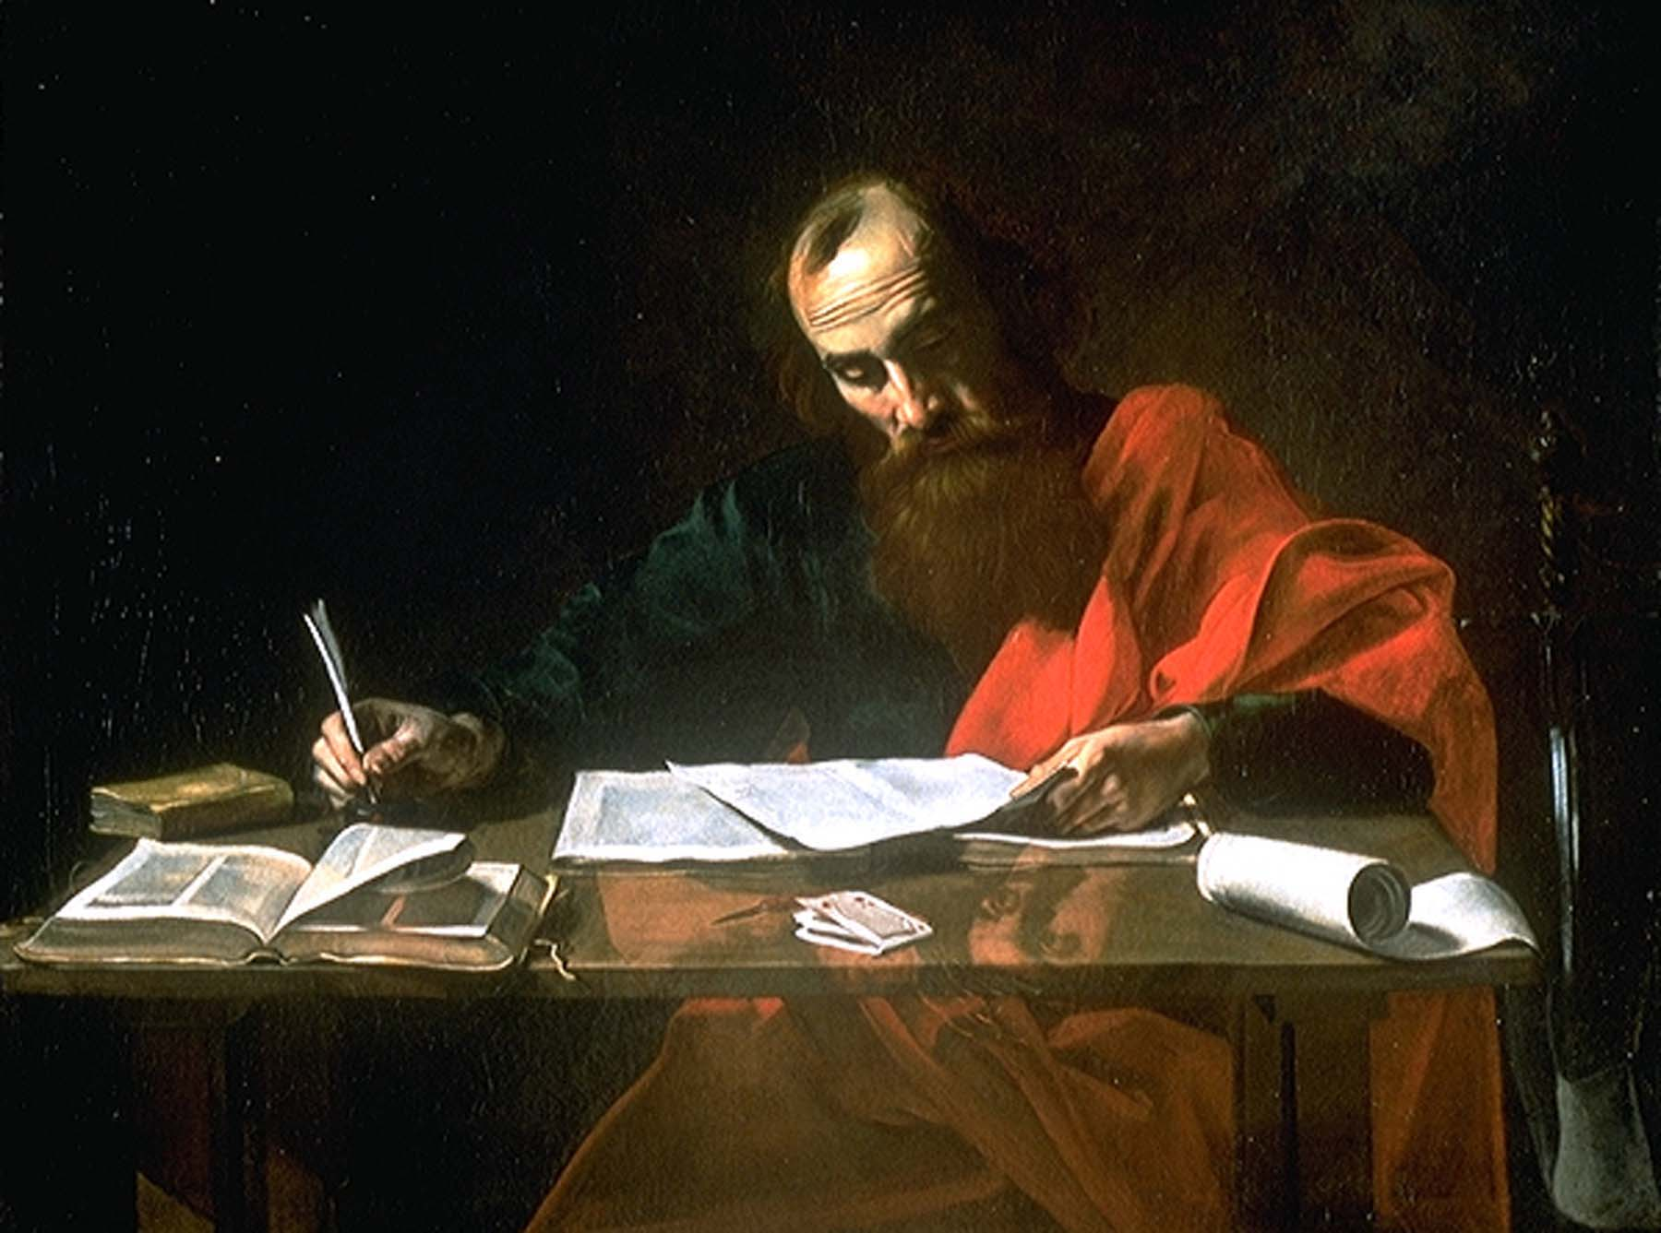

Slide 328
What if I close with ...
... Health and wealth to you all.

Slide 329
What if I close with ...
... Health and wealth to you all in Jesus.

Slide 330
What if I close with ...
... Have fun and enjoy life in Jesus.

Slide 331
What if I close with ...
... He who dies with the most toys wins.

Slide 332
What if I close with ...
... Build your bodies, get fit, lower BMI.

Slide 333
What if I close with ...
... Have a fine family and get all to college.

Slide 334
God had him write...
The grace of our Lord Jesus Christ be with you all. Amen.

Slide 335
What else did this special servant of Jesus Christ say about
God’s Son?

Slide 336
For I determined
not to know
any thing among you,
save Jesus Christ,
and him crucified.
I Corinthians 2:2

Slide 337
For other foundation
can no man lay
than that is laid,
which is Jesus Christ.
Now if any man build
upon this foundation
gold, silver, precious stones
wood, hay, stubble;
Every man’s work shall be made manifest:
I Corinthians 3:11-13

Slide 338
But God forbid
that I should glory,
save in the cross
of our Lord Jesus Christ,
by whom the world is crucified unto me,
and I unto the world.
Galatians 6:14

Slide 339
What was Paul’s great prayer request for Ephesus with
the greatest reward?

Slide 340
That Christ may dwell in your hearts by faith;
that ye, being rooted and grounded in love,
May be able to comprehend with all saints
what is the breadth, and length,
and depth, and height;
And to know the love of Christ,
which passeth knowledge,
that ye might be filled
with all the fulness of God.
Ephesians 3:17-19

Slide 341
Five results for neglecting Christ.
The Holy Ghost will not reveal Him to you.
The Holy Ghost will be a grieved enemy.
You lose offered intimacy with Christ.
God will remove His Spirit and spew you.
If His child, He will grievously scourge you.
John 14-16; Rev 2-3; Heb 12

Slide 342
Would your children rather work out or learn Christ’s will
for their lives?

Slide 343
For bodily exercise profiteth little:
but godliness is profitable unto all things,
having promise of the life that now is,
and of that which is to come.
This is a faithful saying
and worthy of all acceptation.
I Timothy 4:8-9

Slide 344
The body is inferior to the spirit, and emphasizing it will
steal your soul.

Slide 345
But we want to use both body and spirit to honor Jesus Christ,
for He died for both.

Slide 346
What? know ye not that your body
is the temple of the Holy Ghost
which is in you, which ye have of God,
and ye are not your own?
For ye are bought with a price:
therefore glorify God in your body,
and in your spirit,
which are God’s.
I Corinthians 6:19-20

Slide 347
These key verses have nothing
to do with these things:
Tobacco Nutrition
Fitness Clothing
Suntan Junk Food
Alcohol Juicing

Slide 348
These key verses have everything to do with this thing:
Fornication

Slide 349
How can we allow any music
in our ear holes that does
not glorify Christ?

Slide 350
Crown Him with many crowns,
The Lamb upon His throne;
Hark! how the heavenly anthem drowns
All music but its own;
Awake, my soul, and sing
Of Him Who died for Thee,
And hail Him as thy matchless King
Through all eternity.

Slide 351
Crown Him with many crowns,
The Lamb upon His throne;
Hark! how the heavenly anthem drowns
All music but its own;
Awake, my soul, and sing
Of Him Who died for Thee,
And hail Him as thy matchless King
Through all eternity.

Slide 352
Crown Him with many crowns,
The Lamb upon His throne;
Hark! how the heavenly anthem drowns
All music but its own;
Awake, my soul, and sing
Of Him Who died for Thee,
And hail Him as thy matchless King
Through all eternity.

Slide 353
Come, Thou Fount of every blessing,
Tune my heart to sing Thy grace;
Streams of mercy, never ceasing,
Call for songs of loudest praise.
Teach me some melodious sonnet,
Sung by flaming tongues above;
Praise the mount! I’m fixed upon it,
Mount of Thy redeeming love.

Slide 354
Come, Thou Fount of every blessing,
Tune my heart to sing Thy grace;
Streams of mercy, never ceasing,
Call for songs of loudest praise.
Teach me some melodious sonnet,
Sung by flaming tongues above;
Praise the mount! I’m fixed upon it,
Mount of Thy redeeming love.

Slide 355
Come, Thou Fount of every blessing,
Tune my heart to sing Thy grace;
Streams of mercy, never ceasing,
Call for songs of loudest praise.
Teach me some melodious sonnet,
Sung by flaming tongues above;
Praise the mount! I’m fixed upon it,
Mount of Thy redeeming love.

Slide 356
What can we do better to make Jesus Christ more important
in our hearts and lives?

Slide 357
Furthermore then we beseech you, brethren,
and exhort you by the Lord Jesus,
that as ye have received of us
how ye ought to walk and to please God,
so ye would abound more and more.
For ye know what commandments
we gave you by the Lord Jesus.
I Thessalonians 4:1-2

Slide 358
And this I pray, that your love
may abound yet more and more
in knowledge and in all judgment;
That ye may approve things that are excellent;
that ye may be sincere and without offence
till the day of Christ;
Being filled with the fruits of righteousness,
which are by Jesus Christ,
unto the glory and praise of God.
Philippians 1:9-11

Slide 359
Bill, why did you love your business more than me?

Slide 360
I never knew you!
Get out of my sight.
Throw him into hell.

Slide 361
Barb, why did you fuss about good grades but did not teach love of me?

Slide 362
Bob, why did TB12 get your attention, but not my life?

Slide 363
Belle, why did you crave social media friends, but not my friendship?

Slide 364
Bart, you learned verses about me, but you never loved me.

Slide 365
Bonnie, I gave you everything in your life, but I only got your leftovers.

Slide 366
Brad, you doted on your wife and gloried in her, but what about me?

Slide 367
I never knew you!
Get out of my sight.
Throw her into hell.

Slide 368
(For many walk,
of whom I have told you often,
and now tell you even weeping,
that they are the enemies
of the cross of Christ:
Whose end is destruction,
whose God is their belly,
and whose glory is in their shame,
who mind earthly things.)
Philippians 3:18-19

Slide 369
If any man come to me,
and hate not his father,
and mother,
and wife,
and children,
and brethren,
and sisters,
yea, and his own life also,
he cannot be my disciple.
Luke 14:26

Slide 370
God saved you to know and love Himself and His Son ... to love the members of His family ... and to be more and more like Christ.

Slide 371
And this is life eternal,
that they might know thee
the only true God,
and Jesus Christ,
whom thou hast sent.
John 17:3

Slide 372
Beloved, let us love one another:
for love is of God;
and every one that loveth
is born of God,
and knoweth God.
He that loveth not
knoweth not God;
for God is love.
I John 4:7-8

Slide 373
But we all,
with open face beholding
as in a glass the glory of the Lord,
are changed into the same image
from glory to glory,
even as by the Spirit of the Lord.
II Corinthians 3:18

Slide 374
Character without Christ
Is Dung and Loss

Slide 375
Our Christian family is safe for life and eternity!

Slide 376
Not every one that saith unto me, Lord, Lord,
shall enter into the kingdom of heaven;
but he that doeth the will
of my Father which is in heaven.
Matthew 7:21

Slide 377
Every one that heareth these sayings of mine,
and doeth them not,
shall be likened unto a foolish man,
which built his house upon the sand:
And the rain descended,
and the floods came,
and the winds blew,
and beat upon that house;
and it fell:
and great was the fall of it.
Matthew 7:26-27

Slide 378
The ground of a certain rich man
brought forth plentifully:
And he thought within himself, saying,
Soul, thou hast much goods
laid up for many years;
take thine ease,
eat, drink, and be merry.
Luke 12:16-19

Slide 379
But God said unto him, Thou fool,
this night thy soul shall be required of thee:
then whose shall those things be,
which thou hast provided?
Luke 12:20

Slide 381
If any man
love not
the Lord Jesus Christ,
let him be
Anathema
Maranatha.
I Corinthians 16:22

Slide 383
I have by design emphasized children for the parents and children gently and kindly.

Slide 384
But it should start with parents, though I exhort our children
to run to Christ by faith.

Slide 385
Pastor, What Should I Do?
Repent! Like Acts 2:38! Confess your folly to God of neglecting His Son!
Tell God what you will give up and what you will take up to love Jesus!
Make those changes as soon as possible and passionately love His Son!
Remember the five basic inputs (R,P,F,M,E) and turn them inside out!
Live every day in every part of it by GOS with certain eternity in view.
Tell someone what you have done to have an accountability partner.

Slide 386
Everything in you and around you hates Jesus Christ ... your flesh ... the world ... and the devil.

Slide 387
You must change activities and inputs to exalt Jesus Christ to
His rightful place in your life.

Slide 388
It is primarily a change in emphasis and priorities.
It is easy to do ... reorganize your habits and time ... BUT WILL YOU?

Slide 389
What can we do better to make Jesus Christ more important
in our hearts and lives?

Slide 390
The New Testament, written for us by command of Jesus Christ, speaks of His coming.

Slide 391
For our conversation is in heaven;
from whence also we look for the Saviour,
the Lord Jesus Christ:
Philippians 3:20

Slide 392
Looking for that blessed hope,
and the glorious appearing
of the great God and our Saviour
Jesus Christ;
Titus 2:13

Slide 393
So Christ was once offered
to bear the sins of many;
and unto them that look for him
shall he appear the second time
without sin unto salvation.
Hebrews 9:28

Slide 394
And to wait for his Son from heaven,
whom he raised from the dead,
even Jesus,
which delivered us from the wrath to come.
I Thessalonians 1:10

Slide 395
Henceforth
there is laid up for me
a crown of righteousness,
which the Lord,
the righteous judge,
shall give me at that day:
and not to me only,
but unto all them also
that love his appearing.
II Timothy 4:8

Slide 396
What We Can Do to Love Christ More (1)
Talk about Jesus as much as God | Read the Bible to learn about Jesus

Slide 397
What We Can Do to Love Christ More (1)
Talk about Jesus as much as God | Read the Bible to learn about Jesus
Do everything in the name of Jesus | Choose favorite things about Jesus

Slide 398
What We Can Do to Love Christ More (1)
Talk about Jesus as much as God | Read the Bible to learn about Jesus
Do everything in the name of Jesus | Choose favorite things about Jesus
Emphasize a relationship, not facts | He is incredibly personal; you be so

Slide 399
What We Can Do to Love Christ More (1)
Talk about Jesus as much as God | Read the Bible to learn about Jesus
Do everything in the name of Jesus | Choose favorite things about Jesus
Emphasize a relationship, not facts | He is incredibly personal; you be so
Put Him above doctrine, others, etc. | Spend time with those that love Him

Slide 400
What We Can Do to Love Christ More (1)
Talk about Jesus as much as God | Read the Bible to learn about Jesus
Do everything in the name of Jesus | Choose favorite things about Jesus
Emphasize a relationship, not facts | He is incredibly personal; you be so
Put Him above doctrine, others, etc. | Spend time with those that love Him
Work to be a name-dropper like Paul | Find favorite songs chiefly about Him

Slide 401
What We Can Do to Love Christ More (1)
Talk about Jesus as much as God | Read the Bible to learn about Jesus
Do everything in the name of Jesus | Choose favorite things about Jesus
Emphasize a relationship, not facts | He is incredibly personal; you be so
Put Him above doctrine, others, etc. | Spend time with those that love Him
Work to be a name-dropper like Paul | Find favorite songs chiefly about Him
Memorize some verses about Him | Hate news and noise neglecting Him

Slide 402
What We Can Do to Love Christ More (1)
Talk about Jesus as much as God | Read the Bible to learn about Jesus
Do everything in the name of Jesus | Choose favorite things about Jesus
Emphasize a relationship, not facts | He is incredibly personal; you be so
Put Him above doctrine, others, etc. | Spend time with those that love Him
Work to be a name-dropper like Paul | Find favorite songs chiefly about Him
Memorize some verses about Him | Hate news and noise neglecting Him
Pray for God to reveal His Son to you | Let nothing compete in heart or mind

Slide 403
What We Can Do to Love Christ More (1)
Talk about Jesus as much as God | Read the Bible to learn about Jesus
Do everything in the name of Jesus | Choose favorite things about Jesus
Emphasize a relationship, not facts | He is incredibly personal; you be so
Put Him above doctrine, others, etc. | Spend time with those that love Him
Work to be a name-dropper like Paul | Find favorite songs chiefly about Him
Memorize some verses about Him | Hate news and noise neglecting Him
Pray for God to reveal His Son to you | Let nothing compete in heart or mind
Attend and engage in every service | Review sermons about Jesus Christ

Slide 404
What We Can Do to Love Christ More (2)
Thank God for giving His Son for you | The N.T. has many verses about Him

Slide 405
What We Can Do to Love Christ More (2)
Thank God for giving His Son for you | The N.T. has many verses about Him
Bring Him up at every social event | Consciously be a living epistle of Him

Slide 406
What We Can Do to Love Christ More (2)
Thank God for giving His Son for you | The N.T. has many verses about Him
Bring Him up at every social event | Consciously be a living epistle of Him
Examine too much love for anything | Encourage each other to more of it

Slide 407
What We Can Do to Love Christ More (2)
Thank God for giving His Son for you | The N.T. has many verses about Him
Bring Him up at every social event | Consciously be a living epistle of Him
Examine too much love for anything | Encourage each other to more of it
Hate worldly music or entertainment | Avoid those that do not love Him

Slide 408
What We Can Do to Love Christ More (2)
Thank God for giving His Son for you | The N.T. has many verses about Him
Bring Him up at every social event | Consciously be a living epistle of Him
Examine too much love for anything | Encourage each other to more of it
Hate worldly music or entertainment | Avoid those that do not love Him
Serve the church that is His body | Tenaciously protect His supper/table

Slide 409
What We Can Do to Love Christ More (2)
Thank God for giving His Son for you | The N.T. has many verses about Him
Bring Him up at every social event | Consciously be a living epistle of Him
Examine too much love for anything | Encourage each other to more love
Hate worldly music or entertainment | Avoid those that do not love Him
Serve the church that is His body | Tenaciously protect His supper/table
Shout His praise in word or song | Keep His every command obsessively

Slide 410
What We Can Do to Love Christ More (2)
Thank God for giving His Son for you | The N.T. has many verses about Him
Bring Him up at every social event | Consciously be a living epistle of Him
Examine too much love for anything | Encourage each other to more love
Hate worldly music or entertainment | Avoid those that do not love Him
Serve the church that is His body | Tenaciously protect His supper/table
Shout His praise in word or song | Keep His every command obsessively
Use a journal to write praise, prayer | Read poetry of hymns about Christ

Slide 411
What We Can Do to Love Christ More (2)
Thank God for giving His Son for you | The N.T. has many verses about Him
Bring Him up at every social event | Consciously be a living epistle of Him
Examine too much love for anything | Encourage each other to more love
Hate worldly music or entertainment | Avoid those that do not love Him
Serve the church that is His body | Tenaciously protect His supper/table
Shout His praise in word or song | Keep His every command obsessively
Use a journal to write praise, prayer | Read poetry of hymns about Christ
Fear anything too precious to flush | Glory in Him and crucify the world

Slide 412
Pastor, Do You Have Any Sermons to Recommend?
He Is Altogether Lovely ... https://letgodbetrue.com/sermons/index/year-2011/he-is-altogether-lovely/
Unsearchable Riches of Christ ... https://letgodbetrue.com/sermons/index/year-2015/unsearchable-riches/
Knowing Christ ... https://letgodbetrue.com/sermons/index/year-2003/knowing-christ/
Christ in Glory ... https://letgodbetrue.com/sermons/index/year-2014/christ-in-glory/
Hebrews – An Exposition ... https://letgodbetrue.com/sermons/index/year-1988/hebrews/
World’s Greatest Lover ... https://letgodbetrue.com/sermons/index/year-2000/worlds-greatest-lover/
Fellowship with Christ ... https://letgodbetrue.com/sermons/index/year-2013/fellowship-with-christ/
Filled with Fulness of God ... https://letgodbetrue.com/sermons/index/year-2013/filled-with-god/
Drawing Nigh to God ... https://letgodbetrue.com/sermons/index/year-2013/drawing-nigh-to-god/
The Beauty of Jesus Christ ... https://letgodbetrue.com/sermons/the-beauty-of-jesus-christ/
Messianic Psalms ... https://letgodbetrue.com/sermons/index/year-2013/messianic-psalms/
Psalm 45 ... https://letgodbetrue.com/sermons/index/year-2009/psalm-45/
Christ in I Timothy 3:16 ... https://letgodbetrue.com/sermons/index/year-2020/christ-of-i-timothy-316/
Crucifixion in I Timothy 3:16 ... https://letgodbetrue.com/sermons/index/year-2020/crucifixion-in-i-timothy-316/
More Sermons about Jesus Christ ... https://letgodbetrue.com/sermons/index/christ/

Slide 414
Jesus Christ, the Lord of glory, and Judge of all men, has offered
you the unbelievable!

Slide 415
Behold,
I stand
at the door,
and knock:
if any man hear my voice,
and open the door,
I will come in to him,
and will sup with him,
and he with me.
Revelation 3:20

Slide 416
This wonderful offer, based on Him saving us, is in context
with spewing them out.

Slide 417
Like with Lady Wisdom, the judgment for rejecting
the offer is severe.

Slide 418
If thou be wise,
thou shalt be wise for thyself:
but if thou scornest,
thou alone shalt bear it.
Proverbs 9:12

Slide 419
But he that sinneth against me
wrongeth his own soul:
all they that hate me love death.
Proverbs 8:36

Slide 420
Like with the Jews of our Lord’s generation, the judgment for rejecting the offer is severe.

Slide 421
For the days shall come upon thee,
that thine enemies shall cast a trench about thee,
and compass thee round,
and keep thee in on every side,
And shall lay thee even with the ground,
and thy children within thee;
and they shall not leave in thee
one stone upon another;
because thou knewest not
the time of thy visitation.
Luke 19:42-44

Slide 422
Behold,
I stand
at the door,
and knock:
if any man hear my voice,
and open the door,
I will come in to him,
and will sup with him,
and he with me.
Revelation 3:20

Slide 423
God the Father loves His Son, and it is foolhardy in the highest
degree to neglect Him.

Slide 424
For the Father loveth the Son....
For the Father judgeth no man,
but hath committed all judgment
unto the Son:
That all men should honour the Son,
even as they honour the Father.
He that honoureth not the Son
honoureth not the Father
which hath sent him.
John 5:20-23

Slide 425
You cannot go back to days you never truly loved Him
and do better.

Slide 426
As many as I love,
I rebuke and chasten:
be zealous therefore,
and repent.
Revelation 3:19

Slide 428
To him that overcometh
will I grant to sit
with me in my throne,
even as I also overcame,
and am set down
with my Father in his throne.
He that hath an ear,
let him hear
what the Spirit saith unto the churches.
Revelation 3:21-22

Slide 429
For Further Study
The Judgment Seat of Christ ... https://letgodbetrue.com/sermons/index/year-2002/judgment-seat-of-christ/
Warnings about Hell ... https://letgodbetrue.com/sermons/index/year-2017/warnings-about-hell/
Appointed to Death and Judgment ... https://letgodbetrue.com/sermons/index/year-2005/appointed-to-death-and-judgment/
Is There a Burning Hell? ... https://letgodbetrue.com/sermons/index/year-2000/is-there-a-burning-hell/
The Book of Life ... https://letgodbetrue.com/sermons/index/year-2001/book-of-life/
The Cross at Judgment Day ... https://letgodbetrue.com/sermons/index/year-2018/the-cross-at-judgment-day/
Sojourning Here in Fear (I Peter 1:17) ... https://letgodbetrue.com/sermons/index/year-2012/sojourning-here-in-fear/
The Lord’s Coming (Matthew 25) ... https://letgodbetrue.com/sermons/index/year-2005/matthew-25/
Three Choices You Make Daily (slides) ... https://letgodbetrue.com/sermons/index/year-2015/three-choices-for-living/
Two Parables Explained (Matthew 21-22) ... https://letgodbetrue.com/sermons/index/year-2010/two-parables-explained/
Eternal Life Is a Gift ... https://letgodbetrue.com/sermons/index/year-2005/eternal-life-is-a-gift/
Till Death Do Us Part (Funeral Sermon) ... https://letgodbetrue.com/sermons/index/year-2011/till-death-do-us-part-funeral/
Death of the Righteous ... https://letgodbetrue.com/sermons/index/year-1998/the-death-of-the-righteous/
Assurance of Eternal Life ... https://letgodbetrue.com/sermons/index/year-2014/assurance-of-eternal-life/
Accepted and Adopted ... https://letgodbetrue.com/sermons/index/year-2016/accepted-and-adopted/

