Slide 1
Two-Step Bible Study

Slide 2
Two-Step Bible Study
The First Rule of Hermeneutics

Slide 3
Two-Step Bible Study
The Bible Has No Contradictions

Slide 4
Two-Step Bible Study
Starting with the Large Context

Slide 5
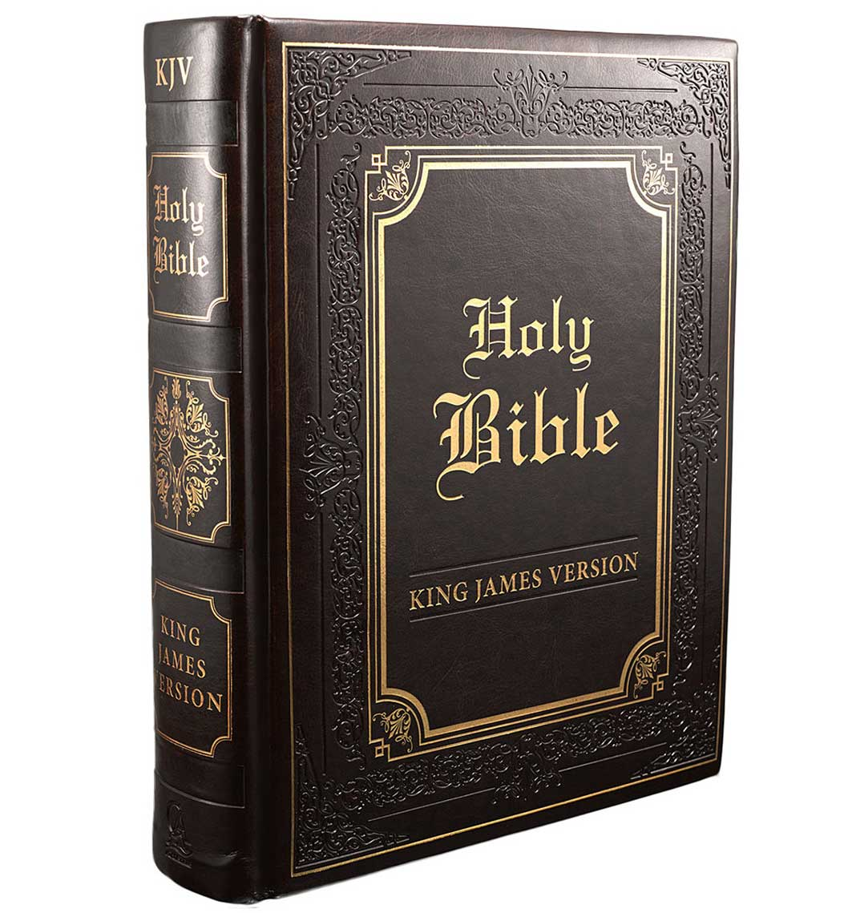

Slide 6
We are
Bible Christians!

Slide 7
19 We have also a more sure word of prophecy; whereunto ye do well that ye take heed, as unto a light that shineth in a dark place, until the day dawn, and the day star arise in your hearts:
20 Knowing this first, that no prophecy of the scripture is of any private interpretation.
21 For the prophecy came not in old time by the will of man: but holy men of God spake as they were moved by the Holy Ghost.
II Peter 1:19-21

Slide 8
The B-I-B-L-E
The B … I … B … L … E,
Yes, that’s the book for me,
I stand alone on the word of God,
The B … I … B … L … E.

Slide 9
Inspiration
Canonicity
Preservation
Interpretation

Slide 10
16 All scripture is given by inspiration of God, and is profitable for doctrine, for reproof, for correction, for instruction in righteousness:
17 That the man of God may be perfect, throughly furnished unto all good works.
II Timothy 3:16-17

Slide 11
15 And account that the longsuffering of our Lord is salvation; even as our beloved brother Paul also according to the wisdom given unto him hath written unto you;
16 As also in all his epistles, speaking in them of these things; in which are some things hard to be understood, which they that are unlearned and unstable wrest, as they do also the other scriptures, unto their own destruction.
II Peter 3:15-16

Slide 12
6 The words of the LORD are pure words: as silver tried in a furnace of earth, purified seven times.
7 Thou shalt keep them, O LORD, thou shalt preserve them from this generation for ever.
Psalm 12:6-7

Slide 13
Study to shew thyself approved unto God, a workman that needeth not to be ashamed, rightly dividing the word of truth.
II Timothy 2:15

Slide 14
We Are Bible Christians … Four Ways!
We believe what it claims about its inspiration!
We believe 66 books of the KJV by canonicity!
We believe word-level truth by preservation.
We give the sense by its rules of interpretation.

Slide 15
Our confidence in all four facts of faith are by the power of God!

Slide 16
17 (As it is written, I have made thee a father of many nations,) before him whom he believed, even God, who quickeneth the dead, and calleth those things which be not as though they were.
18 Who against hope believed in hope, that he might become the father of many nations, according to that which was spoken, So shall thy seed be.
Romans 4:17-18

Slide 17
19 And being not weak in faith, he considered not his own body now dead, when he was about an hundred years old, neither yet the deadness of Sara’s womb:
20 He staggered not at the promise of God through unbelief; but was strong in faith, giving glory to God;
21 And being fully persuaded that, what he had promised, he was able also to perform.
Romans 4:19-21

Slide 18
Two-Step Bible Study

Slide 19
Two-Step Bible Study
The First Rule of Hermeneutics

Slide 20
Two-Step Bible Study
The Bible Has No Contradictions

Slide 21
Two-Step Bible Study
Starting with the Large Context

Slide 22
We first prove what a verse cannot mean!
Then and only then do we try to find its true and proper sense.

Slide 23
We used this rule of Bible study at least twice on Sunday.

Slide 24
19 We have also a more sure word of prophecy; whereunto ye do well that ye take heed, as unto a light that shineth in a dark place, until the day dawn, and the day star arise in your hearts:
20 Knowing this first, that no prophecy of the scripture is of any private interpretation.
21 For the prophecy came not in old time by the will of man: but holy men of God spake as they were moved by the Holy Ghost.
II Peter 1:19-21

Slide 25
19 We have also a more sure word of prophecy; whereunto ye do well that ye take heed, as unto a light that shineth in a dark place, until the day dawn, and the day star arise in your hearts:
20 Knowing this first, that no prophecy of the scripture is of any private interpretation.
21 For the prophecy came not in old time by the will of man: but holy men of God spake as they were moved by the Holy Ghost.
II Peter 1:19-21

Slide 26
19 We have also a more sure word of prophecy; whereunto ye do well that ye take heed, as unto a light that shineth in a dark place, until the day dawn, and the day star arise in your hearts:
20 Knowing this first, that no prophecy of the scripture is of any private interpretation.
21 For the prophecy came not in old time by the will of man: but holy men of God spake as they were moved by the Holy Ghost.
II Peter 1:19-21

Slide 27
19 We have also a more sure word of prophecy; whereunto ye do well that ye take heed, as unto a light that shineth in a dark place, until the day dawn, and the day star arise in your hearts:
20 Knowing this first, that no prophecy of the scripture is of any private interpretation.
21 For the prophecy came not in old time by the will of man: but holy men of God spake as they were moved by the Holy Ghost.
II Peter 1:19-21

Slide 28
This is our first rule of Bible study.

Slide 29
19 We have also a more sure word of prophecy; whereunto ye do well that ye take heed, as unto a light that shineth in a dark place, until the day dawn, and the day star arise in your hearts:
20 Knowing this first, that no prophecy of the scripture is of any private interpretation.
21 For the prophecy came not in old time by the will of man: but holy men of God spake as they were moved by the Holy Ghost.
II Peter 1:19-21

Slide 30
No Contradictions – II Peter 1:20
We accept this as the first rule, for God gave it to us.
Private. Separate, alone, individual, peculiar, special.
No part of scripture can contradict the whole Bible.
There are no contradictions. We reconcile all parts.
Why? Because its 40 writers wrote for One Author!
We assume at all times that every part fits perfectly.

Slide 31
19 We have also a more sure word of prophecy; whereunto ye do well that ye take heed, as unto a light that shineth in a dark place, until the day dawn, and the day star arise in your hearts:
20 Knowing this first, that no prophecy of the scripture is of any private interpretation.
21 For the prophecy came not in old time by the will of man: but holy men of God spake as they were moved by the Holy Ghost.
II Peter 1:19-21

Slide 32
God forbid: yea, let God be true, but every man a liar; as it is written, That thou mightest be justified in thy sayings, and mightest overcome when thou art judged.
Romans 3:4

Slide 33
No Contradictions – Romans 3:4
We start interpretation trusting God’s truthfulness.
Any contradiction is man’s ignorance or confusion.
We accept the premise the Bible is totally perfect.
Interpretation finds solutions exalting Bible integrity.
Any contradictions remaining are our fault, not His.
We reject any thoughts that the text is the problem.

Slide 34
7 For my mouth shall speak truth; and wickedness is an abomination to my lips.
8 All the words of my mouth are in righteousness; there is nothing froward or perverse in them.
9 They are all plain to him that understandeth, and right to them that find knowledge.
Proverbs 8:7-9

Slide 35
No Contradictions – Proverbs 8:7-9
There is nothing untrue, froward, or perverse in it.
Knowledge and understanding make all plain / right.
Confusion or problems are always our ignorance.
Interpretation Bible integrity.
Any, not His.
We reject the problem.

Slide 36
34 Jesus answered them, Is it not written in your law, I said, Ye are gods?
35 If he called them gods, unto whom the word of God came, and the scripture cannot be broken;
John 10:34-35

Slide 37
No Contradictions – John 10:34-35
Jesus said that scripture cannot be broken. Glory!
Every word may be confidently trusted without error.
We use this verse to show arguing individual words.
No matter what we find, we trust it to be fully true.
Anything that looks like a contradiction is our fault.
We love false Bibles, since they are so easy to break!

Slide 38
I have not written unto you because ye know not the truth, but because ye know it, and that no lie is of the truth.
I John 2:21

Slide 39
No Contradictions – I John 2:21
The trust is just that … the truth! It cannot have a lie.
God’s word is truth … and it does not have any lies.
What appears to be a lie is just that – an apparition.
It is our job to always reconcile any apparent lies.
We cannot help the NIV with Goliath or Mark 1:2!
We reject the problem.

Slide 40
19 We have also a more sure word of prophecy; whereunto ye do well that ye take heed, as unto a light that shineth in a dark place, until the day dawn, and the day star arise in your hearts:
20 Knowing this first, that no prophecy of the scripture is of any private interpretation.
21 For the prophecy came not in old time by the will of man: but holy men of God spake as they were moved by the Holy Ghost.
II Peter 1:19-21

Slide 41
No Contradictions – II Peter 1:20
We accept this as the first rule, for God gave it to us.
Private. Separate, alone, individual, peculiar, special.
No part of scripture can contradict the whole Bible.
There are no contradictions. We reconcile all parts.
Why? Because its 40 writers wrote for One Author!
We assume at all times that every part fits perfectly.

Slide 42
Why is this our first rule of Bible study?

Slide 43
Why Is This Our First Rule?
Because we were told it is by God in II Peter 1:20!
Each verse must be limited to only possible solutions.
If we do not start here, then possibilities are infinite.
The single greatest restraint on heresy is this rule.
This rule limits possible senses for the other rules.
With all obvious errors rejected, verses get plainer.

Slide 44
What can happen if we ignore this rule?

Slide 45
I am distressed for thee, my brother Jonathan: very pleasant hast thou been unto me: thy love to me was wonderful, passing the love of women.
II Samuel 1:26

Slide 46
II Samuel 1:26 could be used to prove David and Jonathan were sodomites!

Slide 47
Ye are of your father the devil, and the lusts of your father ye will do. He was a murderer from the beginning, and abode not in the truth, because there is no truth in him. When he speaketh a lie, he speaketh of his own: for he is a liar, and the father of it.
John 8:44

Slide 48
John 8:44 could be used to teach Satan had sex with Eve for British-Israelism!

Slide 49
Look not thou upon the wine when it is red, when it giveth his colour in the cup, when it moveth itself aright.
Proverbs 23:31

Slide 50
Proverbs 23:31 could revive a Temperance Movement against
all alcohol!

Slide 51
So when they continued asking him, he lifted up himself, and said unto them, He that is without sin among you, let him first cast a stone at her.
John 8:7

Slide 52
John 8:7 could end all judgment, since no one is without sin!

Slide 53
How do we apply this first rule of study?

Slide 54
All verses for any subject must be reconciled.
We do not value some verses over others, like Martin Luther rejecting the book of James.

Slide 55
Our two-step method first rules out what a verse cannot mean by the rest of the Bible.
Then and only then do we apply the rest of the rules of hermeneutics to find its positive sense.

Slide 56
Did you catch our two-step
method?

Slide 57
Our two-step method first rules out what a verse cannot mean by the rest of the Bible.
Then and only then do we apply the rest of the rules of hermeneutics to find its positive sense.

Slide 58
We must always reject the dishonest tendency to choose only scriptures agreeing with us.
Arminians do this with John 3:16 and Rev 3:20.
This is the road to heresy on any subject.
It is the total message of scripture that is truth.

Slide 59
Heresies due to ignoring this rule are Legion.

Slide 60
And I will give unto thee, and to thy seed after thee, the land wherein thou art a stranger, all the land of Canaan, for an everlasting possession; and I will be their God.
Genesis 17:8

Slide 61
Genesis 17:8 cannot teach God owes
land to Israel!

Slide 62
And now why tarriest thou? arise, and be baptized, and wash away thy sins, calling on the name of the Lord.
Acts 22:16

Slide 63
Acts 22:16 cannot teach baptismal salvation of Saul!

Slide 64
And when they saw him, they were amazed: and his mother said unto him, Son, why hast thou thus dealt with us? behold, thy father and I have sought thee sorrowing.
Luke 2:48

Slide 65
Luke 2:48 cannot teach Joseph was Jesus’ father!

Slide 66
Else what shall they do which are baptized for the dead, if the dead rise not at all? why are they then baptized for the dead?
I Corinthians 15:29

Slide 67
I Corinthians 15:29 cannot teach baptism for dead relatives!

Slide 68
Christ is become of no effect unto you, whosoever of you are justified by the law; ye are fallen from grace.
Galatians 5:4

Slide 69
Galatians 5:4 cannot teach you can lose eternal life!

Slide 70
But the anointing which ye have received of him abideth in you, and ye need not that any man teach you: but as the same anointing teacheth you of all things, and is truth, and is no lie, and even as it hath taught you, ye shall abide in him.
I John 2:27

Slide 71
I John 2:27 cannot teach that teachers are unnecessary!

Slide 72
This rule is
ignored and abused even worse.

Slide 73
Baptismal regenerationists assume the heresy by their private interpretation of Acts 22:16.
Then they change filth of the flesh in I Peter 3:21 to dirt of the body to force agreement!

Slide 74
Some believe baptismal membership by their private interpretation of Acts 2:41.
Then they force the poor Ethiopian eunuch into the Jerusalem Church he knows nothing of!

Slide 75
Those obsessed with God’s love for all men do so by their private interpretation of John 3:16.
Then they force Romans 9:13 to mean that God just loved Esau a little less than Jacob!

Slide 76
Do you see how neglecting this rule leads to heresy?

Slide 77
They find a sound bite in the Bible and put a meaning on it against the rest of the Bible.
Then they read every verse on that subject in the “light” of their one corrupted verse!

Slide 78
We do the very opposite of them!

Slide 79
We study all Bible verses for any subject and limit every Bible verse to that overall doctrine!

Slide 80
Are there Difficulties with this Rule?
We study the whole Bible for right presuppositions!
All verses on a given topic must be honestly studied.
God inspired sufficient obstacles to save from heresy.
After all, He put this rule first. He will bless its use.
God’s providence will provide an Elihu or Philip.
Consider how God saved us from foot washing.

Slide 81
We have only learned what a verse cannot mean!

Slide 82
Only what a Verse Cannot Mean?
That is true! You grasp the purpose of the first rule!
But it limits study to just a few possible solutions.
With possibilities limited, the other rules work well.
Do not forget this first rule of interpreting verses.
We find the context and doctrine of the whole Bible.
Then and only then do we move to the small context.

Slide 83
19 We have also a more sure word of prophecy; whereunto ye do well that ye take heed, as unto a light that shineth in a dark place, until the day dawn, and the day star arise in your hearts:
20 Knowing this first, that no prophecy of the scripture is of any private interpretation.
21 For the prophecy came not in old time by the will of man: but holy men of God spake as they were moved by the Holy Ghost.
II Peter 1:19-21

Slide 84
We first prove what a verse cannot mean!
Then and only then do we try to find its true and proper sense.

Slide 85
So when they continued asking him, he lifted up himself, and said unto them, He that is without sin among you, let him first cast a stone at her.
John 8:7

Slide 86
This cannot mean sin in general or sexual sins!

Slide 87
Or no man should judge
in any of the five spheres!

Slide 88
For lots more on the first rule of Bible study, go here:
http://www.letgodbetrue.com/bible/scripture/knowing-the-scriptures.php

Slide 89
We Are Bible Christians … Four Ways!
We believe what it claims about its inspiration!
We believe 66 books of the KJV by canonicity!
We believe word-level truth by preservation.
We give the sense by its rules of interpretation.

Slide 90
Inspiration
Canonicity
Preservation
Interpretation

Slide 91
For Further Study
Knowing Scripture … http://www.letgodbetrue.com/bible/scripture/knowing-the-scriptures.php.
Slaves to Context … http://www.letgodbetrue.com/pdf/slaves-to-context.pdf.
Hermeneutics (#1 Slides) … http://www.letgodbetrue.com/pdf/hermeneutics-lesson-one.pdf.
Hermeneutics (#2 Slides) … http://www.letgodbetrue.com/pdf/hermeneutics-lesson-two.pdf.
Hebrews 4:12 (word of God) … http://www.letgodbetrue.com/questions/word-of-god.php.
One Shall Be Taken … http://www.letgodbetrue.com/bible/prophecy/one-shall-be-taken.php.
Genitive Case Phrases … http://www.letgodbetrue.com/pdf/genitive-case.pdf.
Every Word of God … http://www.letgodbetrue.com/pdf/one-word-arguments-titus.pdf.
Salvation Problem Texts … http://www.letgodbetrue.com/sermons/salvation/salvation-problem-texts/sermon.php.
Grammar of Regeneration … http://www.letgodbetrue.com/pdf/grammar-of-regeneration.pdf.
www.LetGodBeTrue.com

